Slide 1

Treasurer’s Report
Annual Meeting
April 27, 2026
Notes:
Note

Slide 2

But first, basketball
Women’s Bracket Winner:
Albert Biscarra (UCLA)
Men’s Bracket Winner:
Steve Crispi (Penn)
Notes:
I also run the AAUDE NCAA tournament pools for the men’s and women’s tournaments. I want to briefly recognize the winners of this years’ pools.
For women, 26 participants
For men, 33 participants
Thank you to everyone who participated.

Slide 3
Treasurer FY26 Updates
FY26 actuals are tracking as expected with the budget
Revised expectations for several items
Annual Meeting projected to run at a deficit again
Notes:
Here are some treasurer updates:
The FY26 budget was approved early this month. Thank you to everyone who joined a Town Hall session and participated in the vote.
Overall, AAUDE remains in strong financial position with a strong income model and significant resources in reserve.
This year’s income and expenses are tracking to the approved budget, which I’ll be getting into on the following slides.
The Annual Meeting is projected to run at a deficit again, which I’ll also have a slide on.

Slide 4
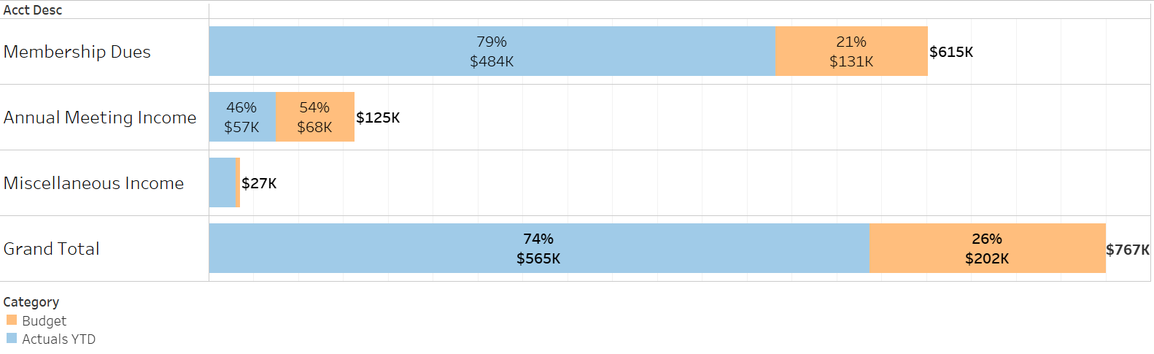
FY26 Income Through Q3
Currently, AAUDE has received 74% of budgeted income through Q3.
Expect to receive all Membership Dues for FY26, but three fewer institutions.
Annual Meeting income likely to fall short of budgeted income. This is due to the budget being created before Annual Meeting figures were revised.
Notes:
The first chart shows membership dues received as a percentage of the approved FY25 budget.
Most of the membership dues are paid during the first half of the fiscal year. So as of Q3 we have received 88% of budgeted membership dues. Another $41k was received during FY24. If you included that prepaid amount we would be at 95% of the budget.
We do not expect to have any issues collecting dues from every institution.
The second chart shows total income excluding the Annual Meeting. As you can see the figures are nearly the same as the membership dues chart because membership dues account for nearly all of our revenue.
Overall we’ve received 89% of the budgeted income with interest from our credit bearing accounts accounting for most of that additional money.

Slide 5
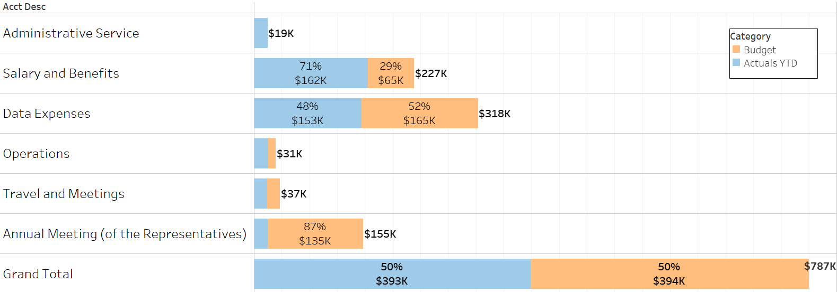
FY26 Expenses Through Q3
Currently, AAUDE has received 50% of budgeted expenses through Q3.
Q3 data warehouse invoice paid right after Q3 closed.
Most Annual Meeting expenses haven’t hit yet. Expect to be less than budgeted amount.
All other categories expect to be at or slightly less than budgeted amounts.
Notes:
This chart shows actual expenses as a percentage of budgeted expenses by budget category
Expenses are more spread out over the fiscal year.
The largest expense categories, salary and benefits and data warehouse, have regular transactions throughout the year. The data expenses appear low in this snapshot because the third quarterly payment to MIT is due on April 1st.
Expenses for operations have already exceeded the annual budget by about $4k. This is due to higher than expected expenses for meeting planning, that’s the Helms Briscoe firm we use to help with the annual meeting, and for Computer Software.
Travel is already at 86% of the annual budget.
We’re doing a good job of spending to budget in these categories. That had been an issue following the pandemic, but last year and this year have been back on track.
MIT quarterly payment: July 1, October 1, January 1, and April 1

