Slide 1

AAU Update
April 2026

Slide 2
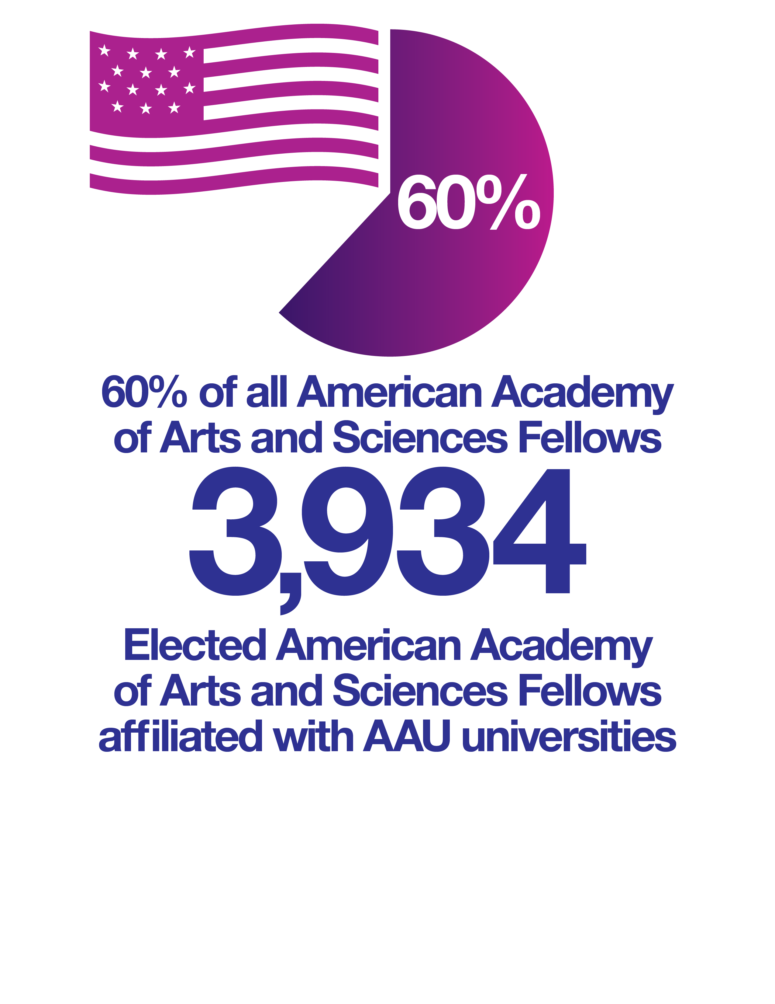
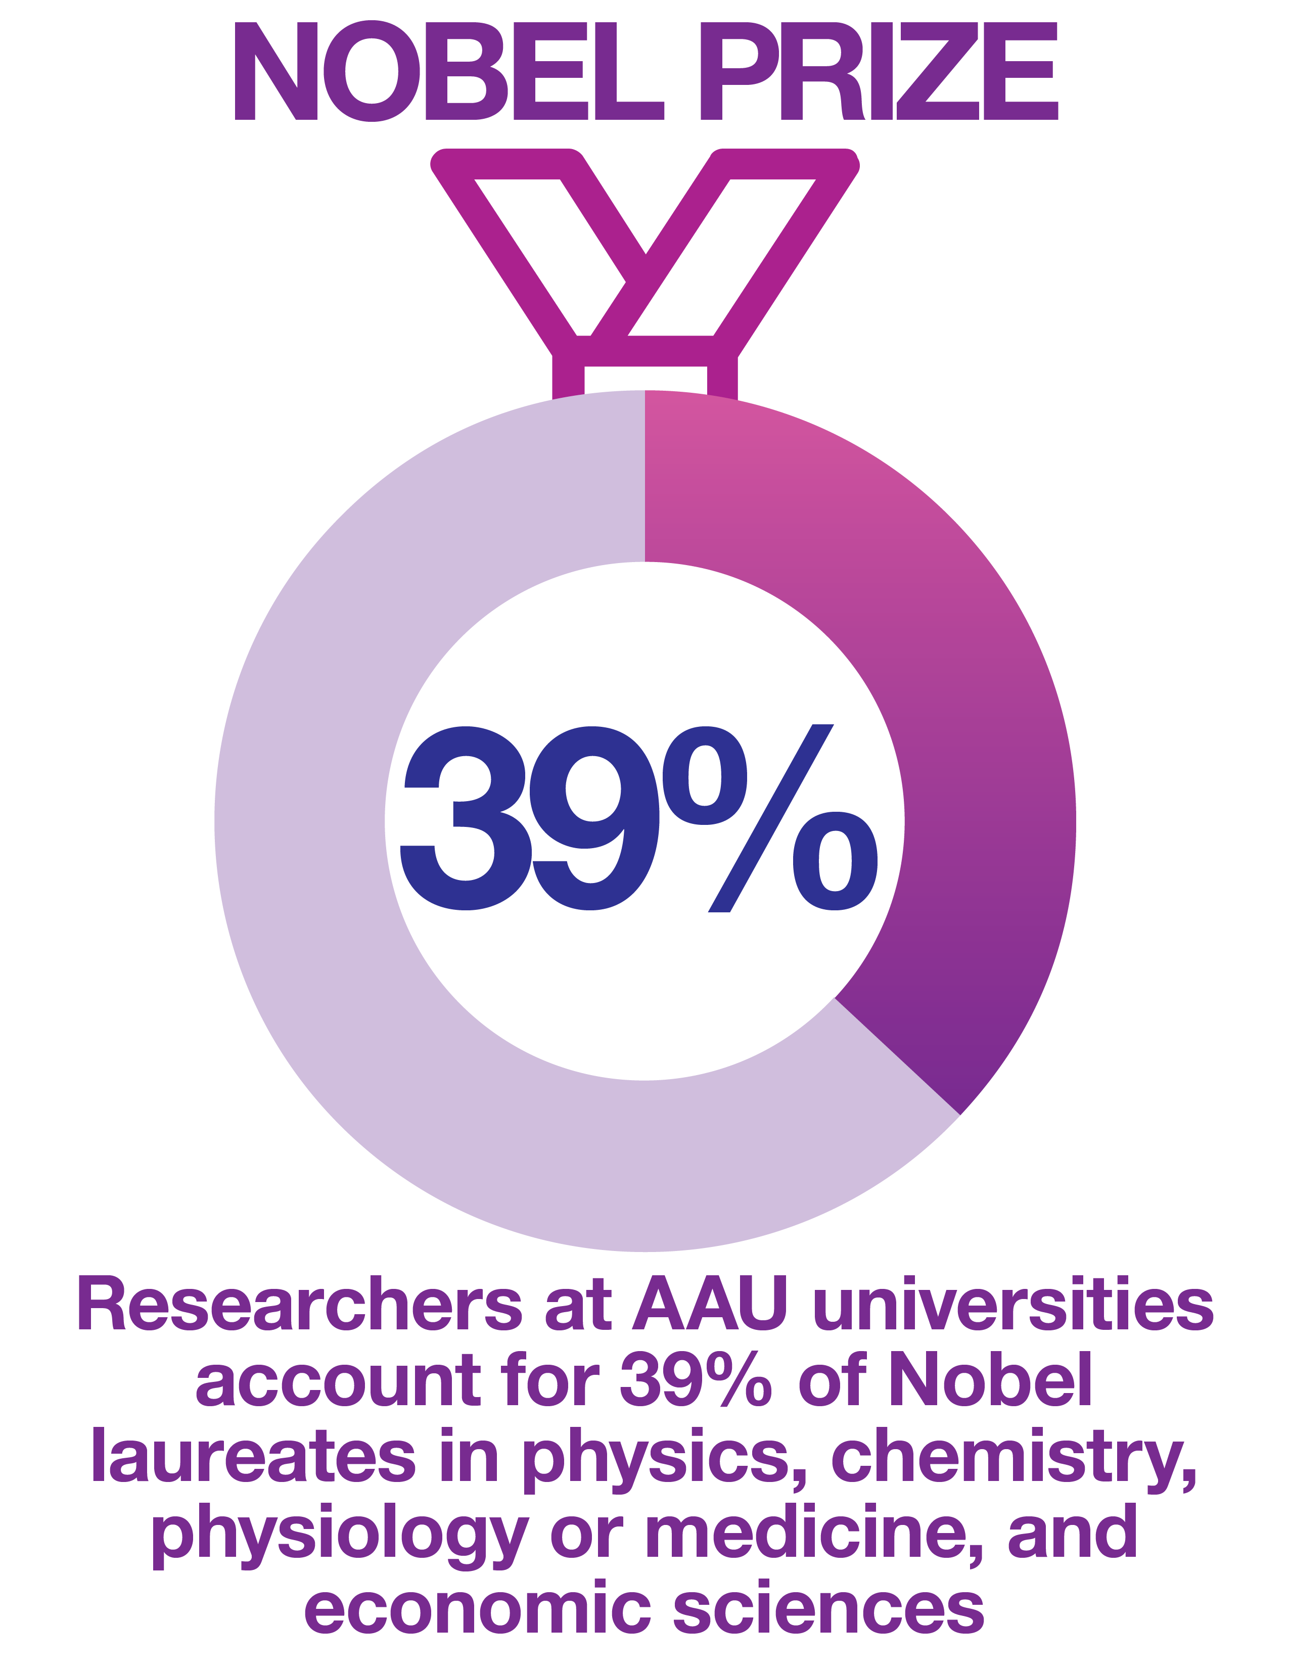
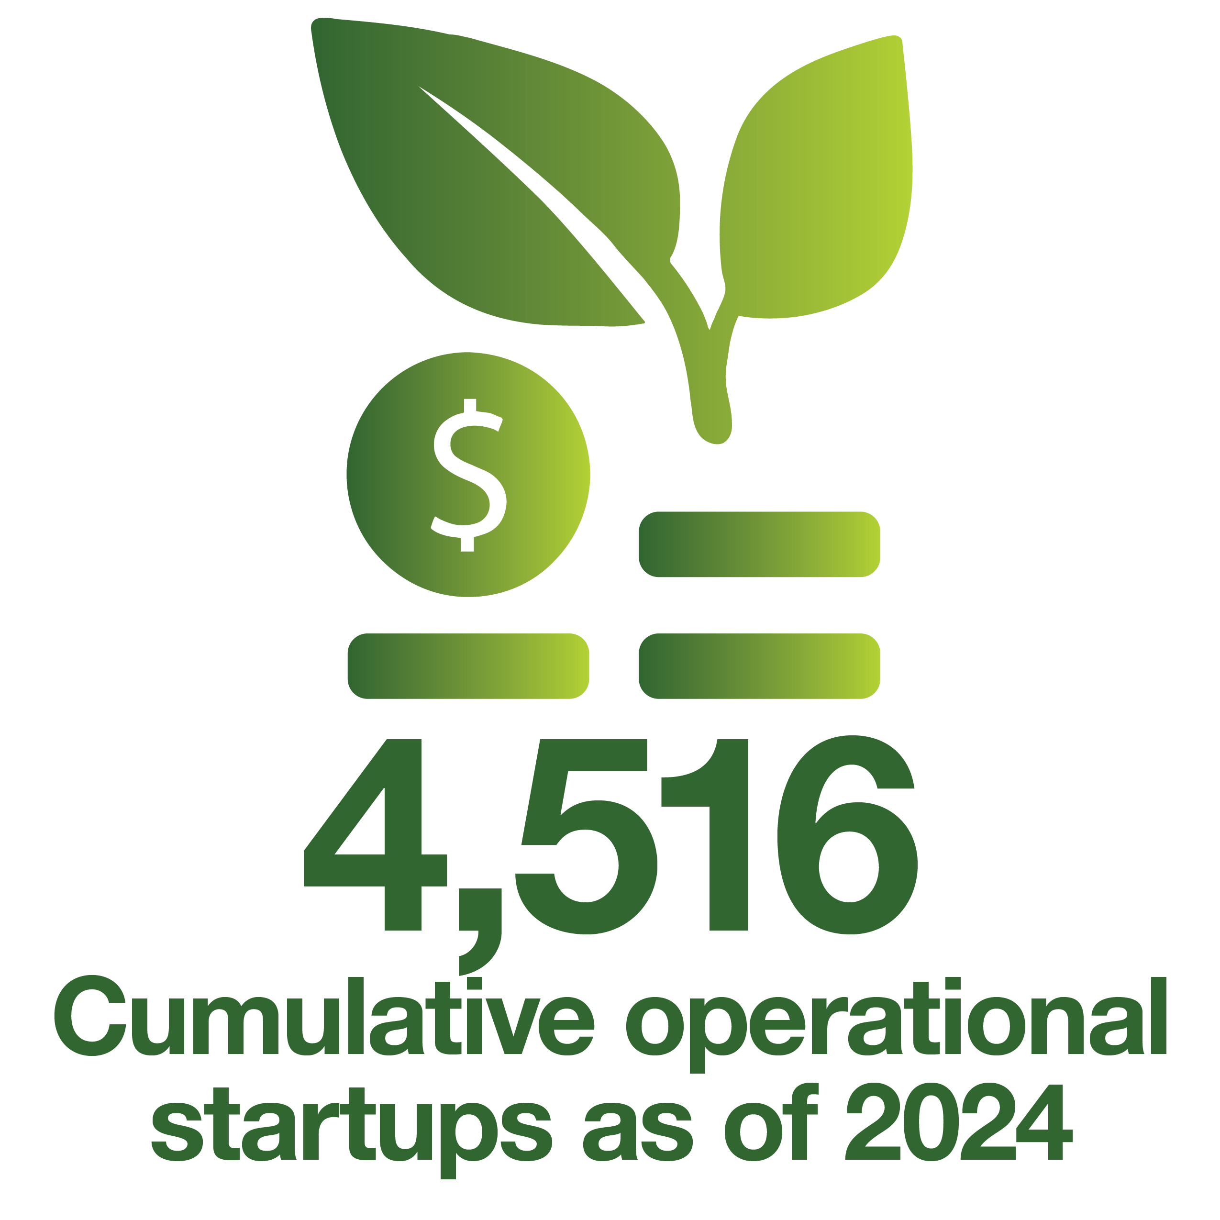

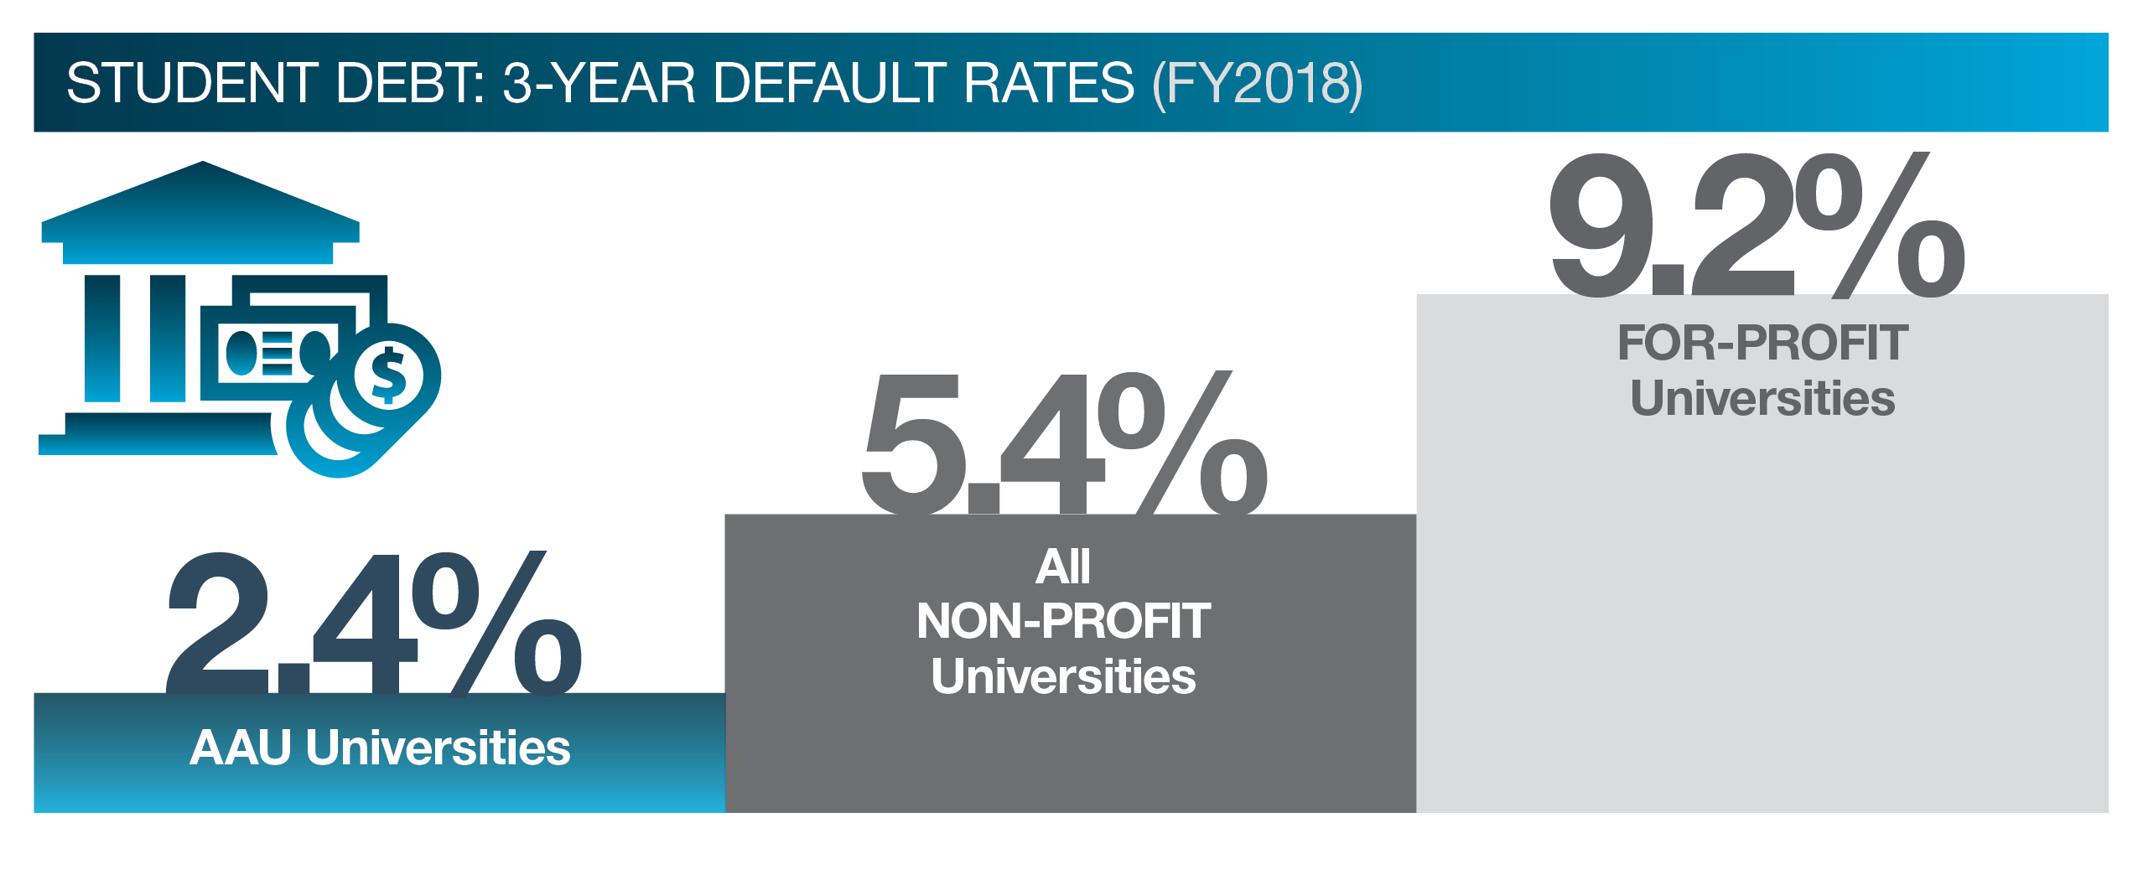


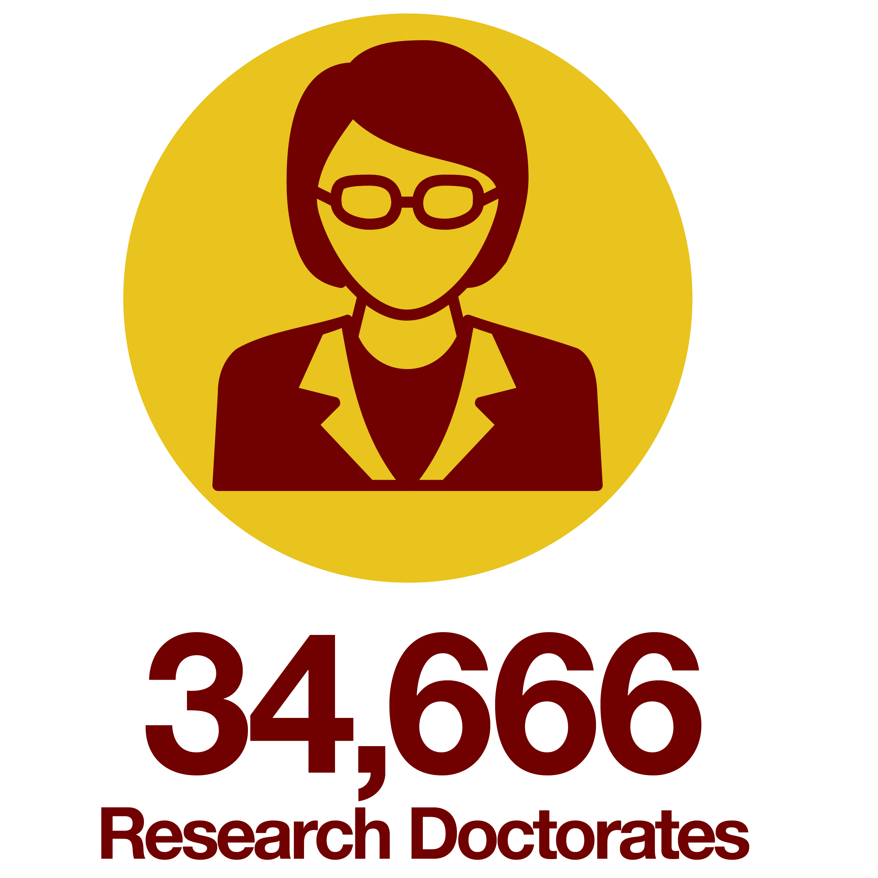
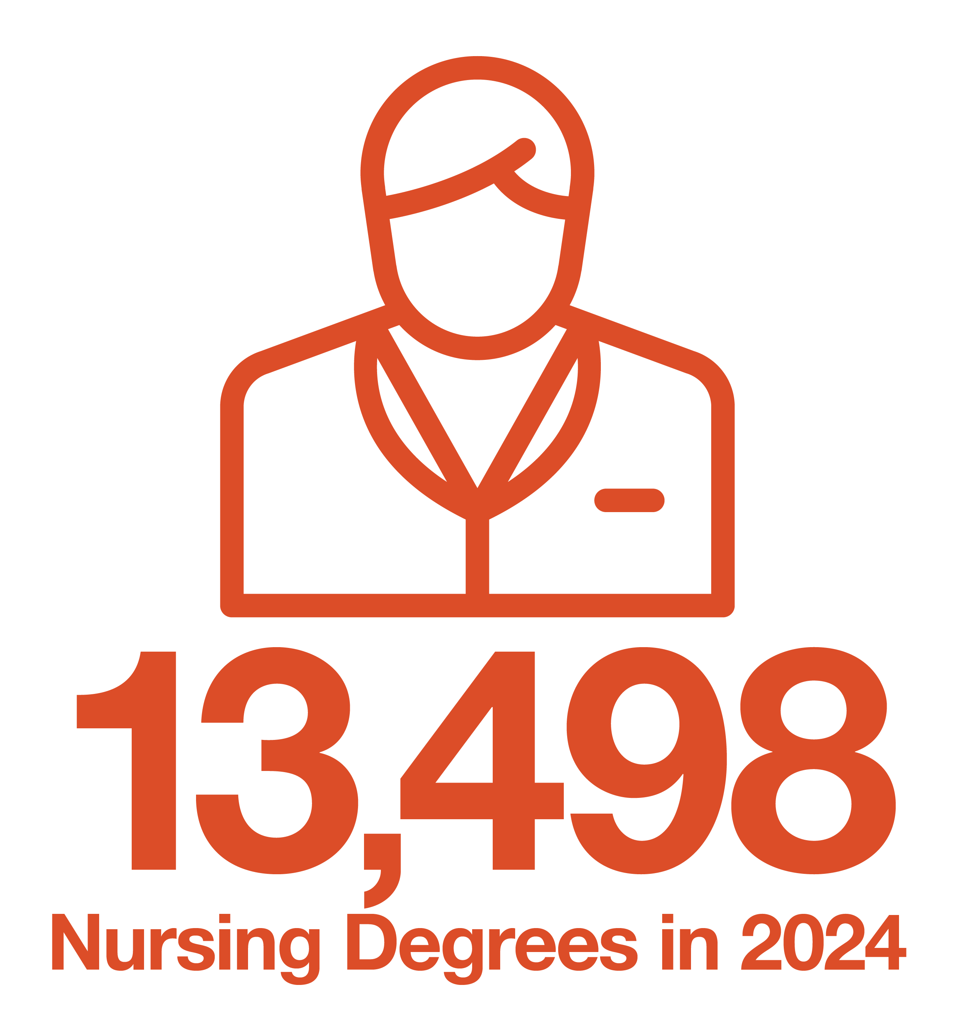

AAU By The Numbers
Leveraging stats to reinforce messaging priorities
Newsletter: Data Show Outsized Economic Impact and Value of America’s Leading Research Universities
By the Numbers | Association of American Universities (AAU)
Notes:
Economic impact, research, value, and education

Slide 3
Fall 2026 Enrollment
• Significant Interest: Understanding impacts of recent policy changes
  Graduate Education
  International Students
• December 2025 Data Request: Early insight into reporting
  Established definitions to minimize burden
• Upcoming Request
  Graduate Education
  International Students
1200 New York Ave, NW, Washington, DC, 20005, Suite 500 ● 202.408.7500 ● www.aau.edu ● @AAUniversities

Slide 4
2026 Advocacy Agenda
• Research Funding : Sustained funding for federal research agencies (NIH, NSF, DOD, DOE, NASA, etc.)
• Research Policy: Support research policy priorities that strengthen U.S. research ecosystem, oppose policies that undermine it (research excellence, Bayh-Dole, research security, etc.)
• Workforce: Advance policies that promote stronger domestic and international talent recruitment and retention
• Higher Education: Illustrate the value of higher education and promote policies that further access, affordability, and accountability (graduate education and professional loans, Pell/financial aid programs, data reporting, messaging on affordability, etc.)
1200 New York Ave, NW, Washington, DC, 20005, Suite 500 ● 202.408.7500 ● www.aau.edu ● @AAUniversities

Slide 5
2025-26 Advocacy Successes
  F&A – Blocking Language/FAIR model/F&A Cap Lawsuit Outcomes
  Research Funding/Appropriations
  NDAA - SAFE Research Act/DETERRENT Act
  SBIR/STTR Reauthorization
  Doing and Thinking Differently

Slide 6
Major Concerns for 2026
  Significant budget cuts to key science agencies have been proposed (NSF, NASA, NIH, DOE Science, DOD basic 6.1 research and financial aid programs).
  Expenditure of FY 2026 appropriated funding
  Continued pressure to cap or reduce indirect/F&A costs coming from the administration
  Defunding of social sciences, humanities & specific politicized areas of research (e.g., mRNA; vaccine research; health disparities: climate)
  Movement away from fundamental, curiosity-driven research
  Continued use of forward funding of grants
  Immigration policies which threaten our ability to attract and retain international talent
  Continued reorganization of key science agencies
  Continued attacks on research universities & academic freedom (e.g., Compact 2.0)
  Potential tax on royalties on university-based discoveries
  Continued challenges to the use of merit review to fund research awards
  Scientific openness will be challenged
    Research Security and concerns regarding China and Middle Eastern Countries
    Future of Nelson Memo uncertain

Slide 7
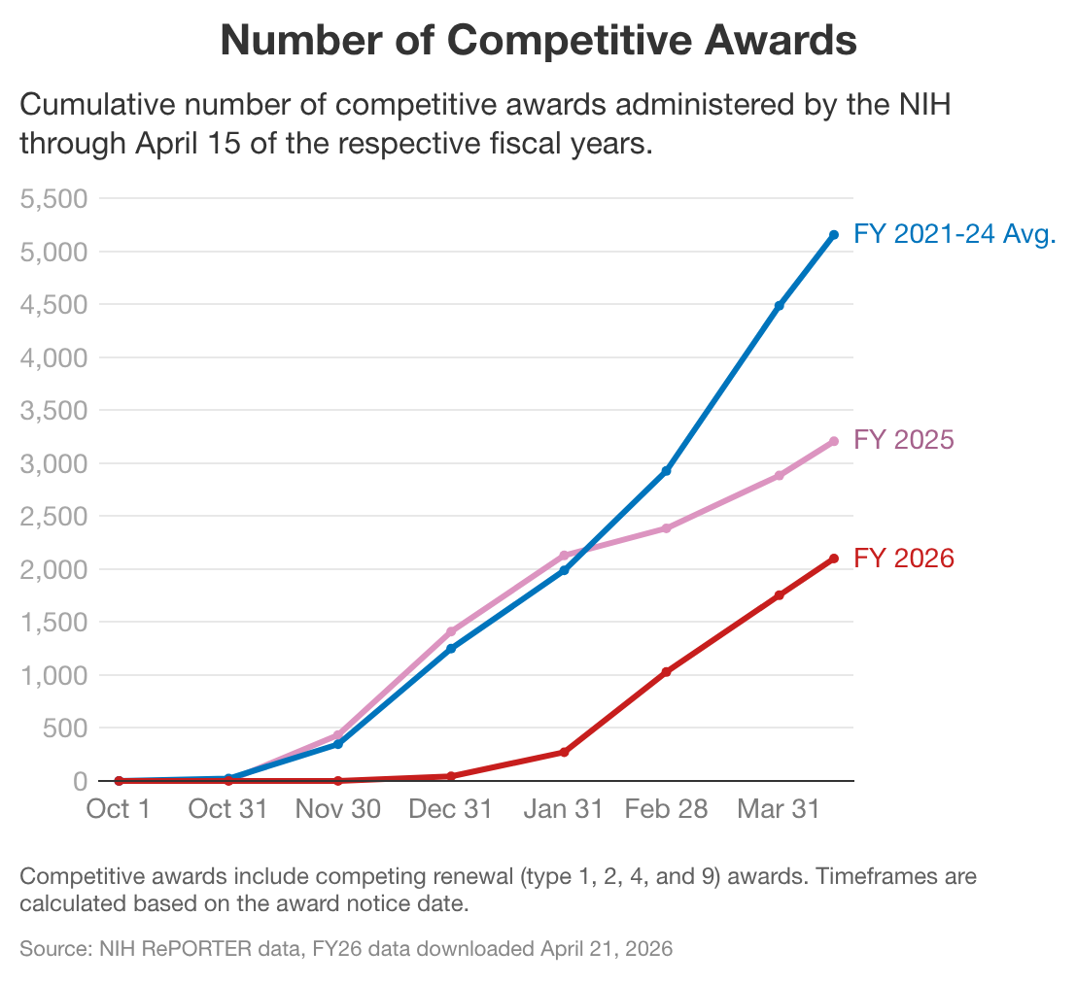
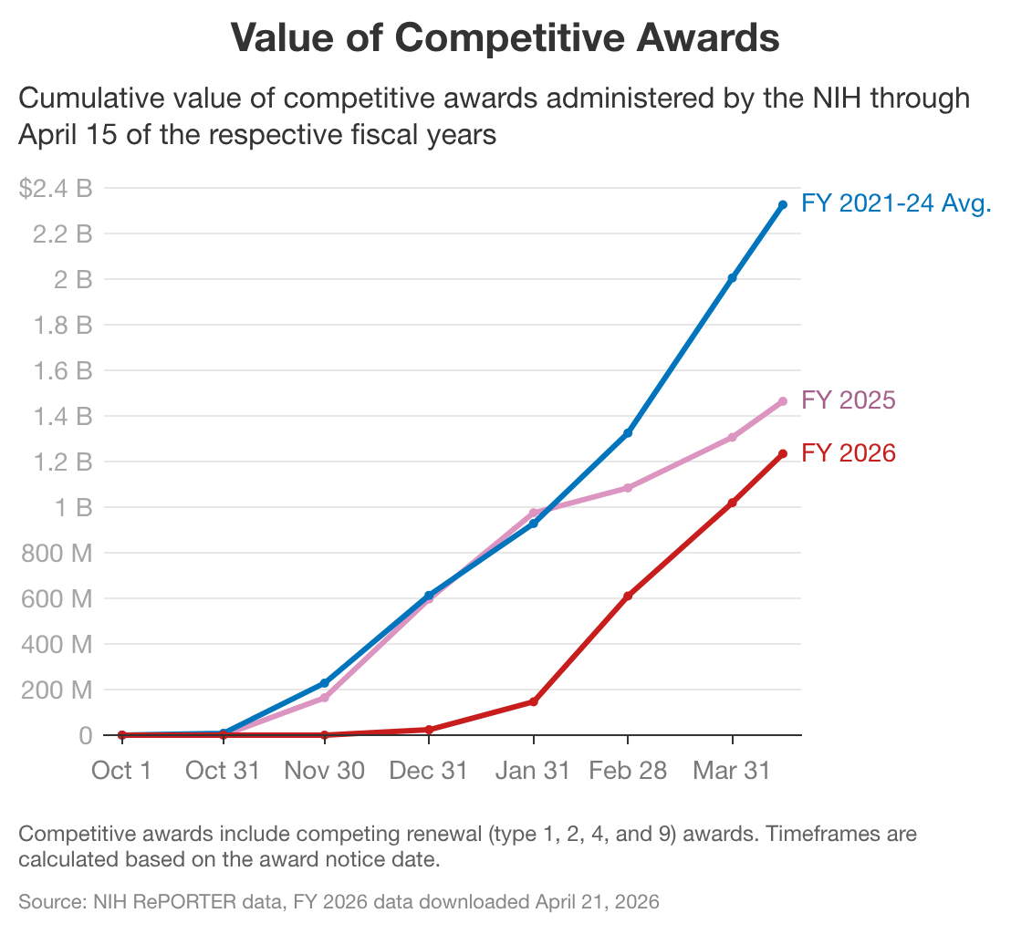
FY26 Research Spending
NIH has awarded:
59% fewer awards
and
47% fewer dollars
to new and competing grants through April 15 compared to the average of
FY 21-24
Other agencies: ScienceSpending.org
1200 New York Ave, NW, Washington, DC, 20005, Suite 500 ● 202.408.7500 ● www.aau.edu ● @AAUniversities

Slide 8
F&A and the FAIR Model
  Message:
    Caps on F&A are cuts to research.
    Financial Accountability in Research (FAIR) model increases transparency and accountability.
  Focus – Focus this year is on advancing legislative language to implement FAIR model across all agencies in the FSGG appropriations bill.
  Building Support – Association and Institutional support letters; member appropriations requests; working with key congressional members.
  Blocking Language – Statutory language prohibiting capping existing F&A included in final FY26 L-HHS-Ed, CJS, Defense, and Energy & Water Appropriation acts; explanatory language in the FSGG act.
  OMB Uniform Guidance – forthcoming OMB Guidance not expected to contain changes to F&A; separate guidance still possible.

Slide 9
FY27 Funding
NSF:
  FY27 PBR: $3.9 billion, 54% cut ($4.8 billion)
  FY26 Final: $8.75 billion
  NIH:
  FY27 PBR: $41.4 billion, 12% cut ($5.8 billion)
  FY26 Final: $47.2 billion
  DOD 6.1 Basic Research:
  FY27: $2.1 billion, 10% cut ($229.5 million)
  FY26 Final: $2.37 billion
  DOE Office of Science:
  FY27 PBR: $7.1 billion, 13.5% cut ($1.1 billion)
  FY26 Final: $8.2 billion
NASA:
  FY27 PBR: $18.83 billion, 23% cut ($5.61 billion)
  FY26 Final: $24.44 billion
  NASA Science:
      FY27 PBR: $3.89 billon, 46% cut ($3.35 billion)
      FY26 Final: $7.25 billion
Department of Education:
  FY27: 2.9% cut
    Financial Aid:
    Pell: 47% increase, no change to max award
    Federal Work Study: 90% cut
    Other Financial Aid Programs: Eliminates SEOG, TRIO, GAANN

Slide 10
Litigation Update
Case | Current Status | Practical Impact
AAU v. HHS (F&A rate) | The district court enjoined and vacated the NIH policy. The First Circuit affirmed on appeal. The government did not seek cert at the Supreme Court. | Litigation complete; win for plaintiffs.
AAU v. DOE (F&A rate) | The district court vacated the policy. The government appealed, then dismissed their appeal. District court order is final. | Litigation complete; win for plaintiffs.
AAU v. NSF (F&A rate) | The district court vacated the NSF policy. The government appealed, then withdrew their appeal. The district court’s decision is now final. | Litigation complete; win for plaintiffs.
AAU v. DOD (F&A rate) | The district court vacated the DOD policy. On Dec. 9, the government filed an appeal, then dismissed their appeal. | Litigation complete; win for plaintiffs.
Chamber of Commerce et al. v. DHS (H-1B fee) | District court ruled in favor of the government. Chamber of Commerce and AAU have appealed. Oral arguments were held March 9; no decision yet. | None yet.
Commonwealth of Massachusetts, et al., v. ED (ACTS) | AAU’s motion to intervene was granted. Indefinite preliminary injunction granted on Apr. 24. | Data submission deadline suspended.
  Most Current Updates: AAU Litigation Resources

Slide 11
Department of Education
Presidential Budget Request zeroed out all student aid accounts except:
  Pell:$33 billion (maintains maximum award of $7,395)
  Federal Work Study: reduced to $123 million
Accreditation, Innovation, and Modernization Negotiated Rulemaking:
  Session 1: April 13 – April 17
  Session 2: May 18 – May 22

Slide 12
Research & Institutional Policy
Public Opinion Research
National public opinion survey research to understand higher education issues and the perception of research universities.
Custom campus-based surveys for AAU members focused on internal audiences or state/regional public opinion.
Data & Policy Analysis
Use data sets and tools to understand the impact and influence of federal policy and regulations as well as to create data visualizations.
Institutional Policy
Strategic initiatives with member campuses to advance institutional priorities related to research and education.
Leverage institutional data to understand cross cutting issues of importance to AAU members.
Represent AAU campuses in national forums.
Help member campuses be responsive to opportunities and challenges confronting leading research universities.

Slide 13
Public Opinion Research
New Approach & Defining Features
Greater emphasis on message development.
Research design included understanding the opinion of both the general public, and republican policymakers and policy staff.
Two quantitative surveys: 1) Republican policy elites in the D.C. area. 2) National registered voters with an oversample of Republican primary voters.
Conducted grass top qualitative research: Individual in-depth interviews with GOP policymakers, as well as focus groups with GOP policymakers and GOP primary voters.

Slide 14
Communications
• Weekly Newsletter: Leading Research Universities Report
  View Articles & Sign Up
• Additional Staff Support
  More issue briefs, one pagers, and web pages
    Federal Investment in Science Fuels America’s Global Leadership
    Congress Must Delay Implementing New Graduate and Professional Loan Caps
• AAU Website Update
  Coming this summer

Slide 15
Update: digital communications campaigns
“Break Through”: Brand Perception Campaign 2025
  Focused campaign: DC-policymaker, staff, and policy influencer audience
  Utilizing digital assets and tactics honed in our Fall 2024 and March-Dec 2025 Break Through campaign
  Ended Dec 2025. Re-started mid-April for an abbreviated run ending July.
“In Their Own Words”: Break Through research beneficiary videos campaign
  With leads from your Comms/Marketing leaders we developed, produced, and promoted five very short videos in 2025 in the voices of people whose lives have benefitted from university research (medical, agricultural, engineering, etc).
  Promoted via social, display ads, CTV devices (e.g. via Roku boxes) & Over-The-Top-TV (e.g. Hulu). Ended Dec 2025 (see above). Restarted mid-April in fewer channels ending July.
“Research for a Stronger America” campaign: ”Keep America Winning”
  Designed to reach both a bespoke national conservative influencer audience AND civically engaged constituents in key geographic areas, urging them to call/write congress to encourage them to protect funding for critical university research. Launched June 2025 and running through February 2027

Slide 16

“Break Through” Campaign
(Summary of the six pillar/ad “click through” landing pages here: https://www.aau.edu/americas-leading-research-universities-break-through )
Notes:
The brand perception campaign we developed was named “Break Through,” a double meaning, the noun of which (i.e. one word “breakthrough”) connotes major, beneficial scientific advancements. But as two words it’s also a disruptive action VERB: America’s leading research universities DON’T sit on their laurels and DON’T do this work FOR THEMSELVES but are at work every day to “break through” to solve problems facing individuals and families, communities, and the nation.

Slide 17
“Keep America Winning”: Protecting Funding for Critical University Research
Targeted grassroots campaign to get constituents to tell their reps in Congress about their support for federal research
Research for a stronger America (501c4)
Research for a Stronger America | ResearchFor.us

Slide 18
Questions
Emily.miller@aau.edu
Graham.Andrews@aau.edu

