Slide 1

The 2025 AAUDE
IR Office Landscape
From Data Providers to Strategic Translators
An analysis of the 2025 Institutional Research Office Survey and implications for AAUDE membership.

Slide 2
IR Office Survey Purpose
Better understand the structure of IR offices at AAU institutions;
Inquire into functions, tools, and other pertinent information to inform AAUDE’s focus areas and ensure alignment with the needs of our membership; and
Serve as a valuable tool for member institutions to use for office planning by benchmarking office structures and responsibilities against those of other AAU IR offices.

Slide 3

Approach streamlined, measures remained consistent
Incorporated a “no change from 2024” option as a survey screener.
Organization structures
Current Responsibilities (primary, shared, or no oversight)
FTE and full-time/part-time headcounts (gender and IPEDS race/ethnicity optional items)
Work arrangements (in-person, hybrid, remote)
Analytics/visualization tools utilized
Products utilized
Regular presence at consortia/conferences
Strategic plan and website location (if applicable)
Biggest obstacles (open text)
Office strengths (open text)

Slide 4
Administration Overview
Population: AAUDE Primary Representatives
Administration: November 13 - December 12, 2025
Population | Respondents | Response Rate
72 | 48 | 67%
9 institutions participated in 2024 and not in 2025
7 participated in 2025 and not in 2024

Slide 5

Methodological Context and Key 2025 Takeaways
Interpretation Caveats
Aggregate stability masks institutional restructuring and staffing for some institutions.
No Change Option
  38 institutions reported changes
  10 reported no changes
The respondent pool changed between 2024 and 2025, so year-over-year dashboard comparisons should be interpreted with caution.
The 2025 results are not a perfect comparison with 2024, as some new institutions participated while some prior did not.
IR strengths are maturing into
strategic translation and complex modeling.
Core reporting (IPEDS, rankings)
remains, while strategic and external demands are stretching capacity to its limits.

Slide 6
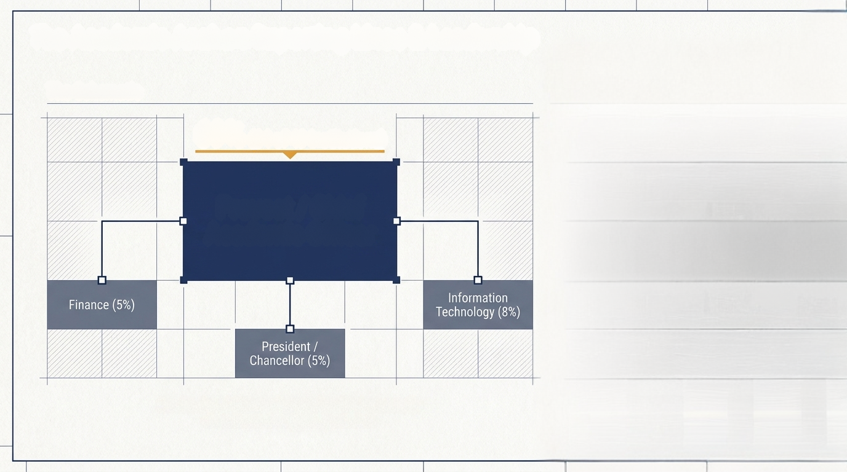
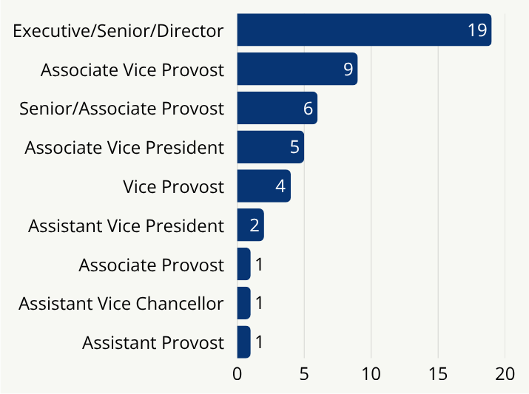
The Academic Anchor: Reporting Lines & Leadership
69%
(34 of 49 Institutions)
Leadership titles shifted modestly, but changes were institution-specific and often reflected scope, wording, or perhaps organizational repositioning.
Provost/Chief
Academic Officer
Institutional Research remains fundamentally housed in the academic arm of their institution.

Slide 7
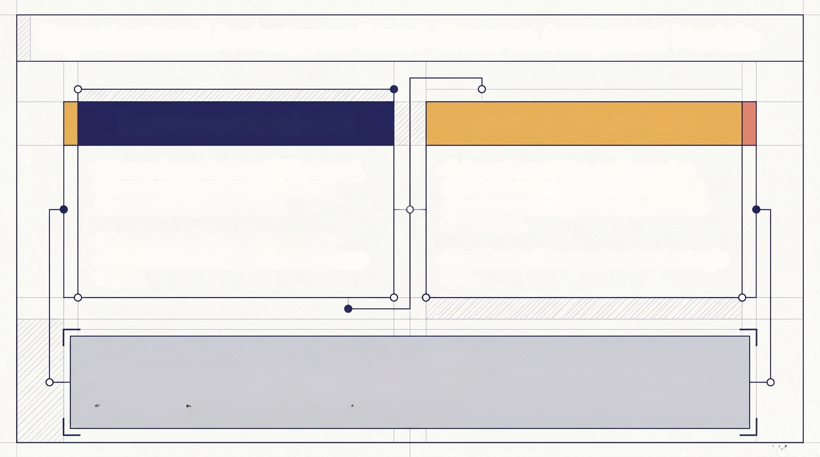
Organizational Structures: Stand-Alone vs. Integrated Models
Stand-Alone IR Unit (~66%)
Integrated IE Unit (~34%)
Primary Focus: Rankings (84%),
Government Reporting (77%), Survey Research (58%), University Dashboards (58%), and Census Files (55%).
Primary Focus: Government Reporting (94%), Rankings (88%), Faculty Salary Analyses (56%), University Dashboards (56%), Faculty Data and Analysis (50%)
Structural Models Shifted for Some Institutions
From 2024 to 2025, four institutions reported moving to stand-alone models, while four others were integrated into broader planning and effectiveness structures.

Slide 8

Among institutions reporting change, the core IR portfolio remained largely intact. However, they also pointed to a broadened portfolio that included data/AI strategy, data procurement, enrollment planning, and tuition revenue modeling.
Space Planning
Graduate/Undergraduate
Admissions
Data Governance &
AI Strategy
University
Dashboards
Government reporting, rankings, survey research, dashboards, and census/frozen files
Primary
Oversight
Financial Aid
Modeling
Predictive
Modeling
Faculty Data &
Salary Analysis

Slide 9
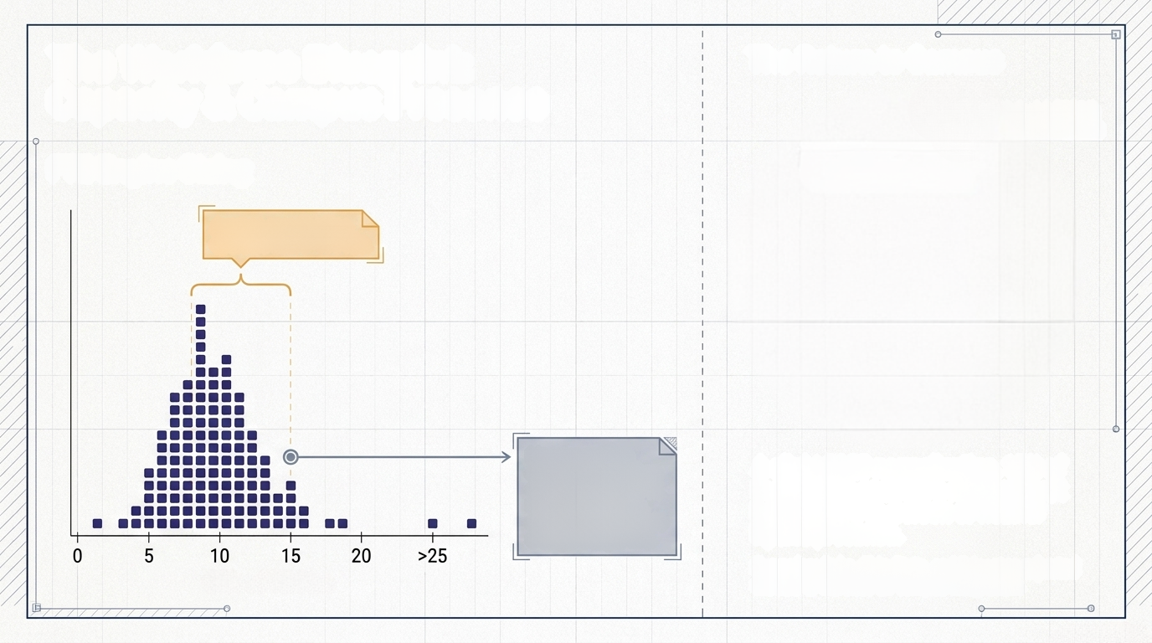


The Workforce Blueprint:
Capacity
Full-time Headcounts
Public Institutions
Staffing capacity remains an important context for interpreting workload, ad hoc demand, and the ability to expand into analytics, governance, and strategic support.
Mean: 11
Median: 10
Mode: 7
IR Office Average FTE
Typical IR offices cluster around 7–10 FTE
Private Institutions
Mean: 7
Median: 7
Mode: 8 & 10
Public institutions tend to report larger teams, while private institutions cluster at slightly lower FTEs.
Staffing changes were mixed: among institutions reporting in both years, FT headcount shifts ranged from -15 to +8, with no clear overall growth or decline trend.
Office FTE Size

Slide 10
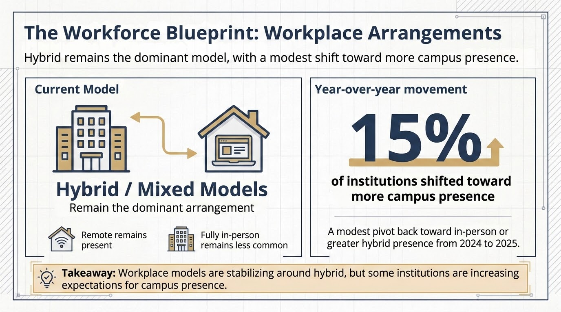

Slide 11
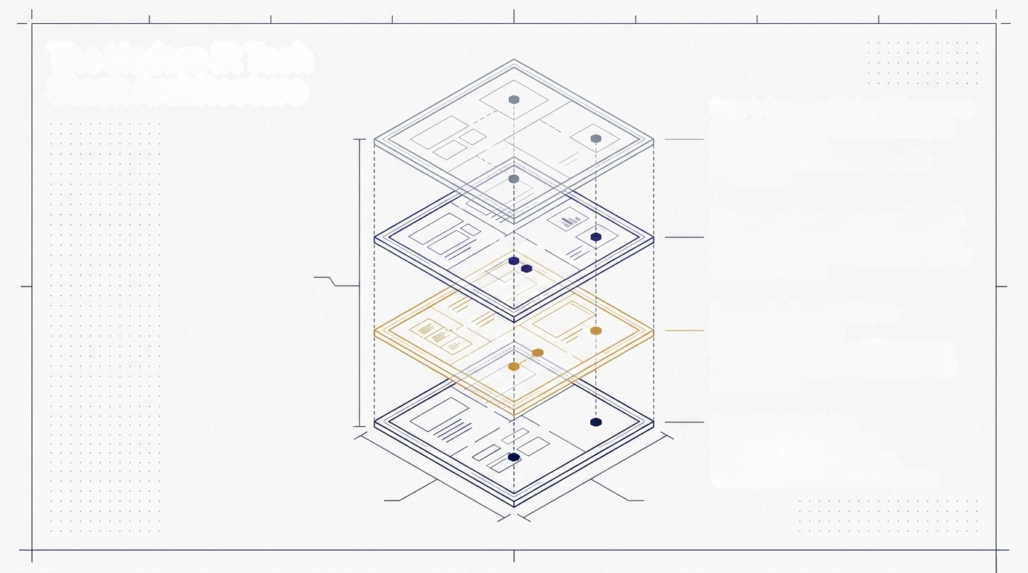
The IR Technology Architecture
Layer 4: Benchmarking Tools
Academic Insights (76%), Academic Analytics Faculty (69%) and Alumni (41%), Interfolio (24%)
Layer 3: Visualization
Tableau (92%), PowerBI (24%)
Layer 2: Analysis & Modeling
R (87%), SPSS (71%), Python (61%), SAS (47%), AWS (18%)
Layer 1: Data Collection & Datasets
Excel (97%), Qualtrics (74%), Microsoft Access (37%)

Slide 12
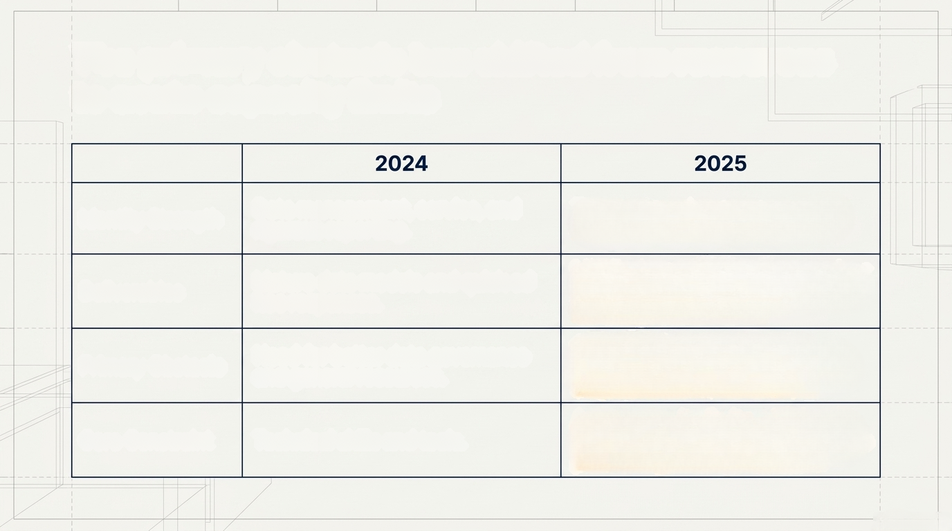
The primary obstacle has shifted from resources to acute capacity limits
Data management, service, and rigorous reporting
Trusted translators, connectors, and strategic data partners
Identity Strength
Mature data models and quick ad hoc responses
Clear summaries of complexity, and actionable information
Deliverables
Need for better data governance and general resources
Operating in a reactive, high-demaind environment
Primary Obstacle
Acute capacity limits, shifting priorities, and compliance burdens
Core Constraint
Technical skills and tools

Slide 13
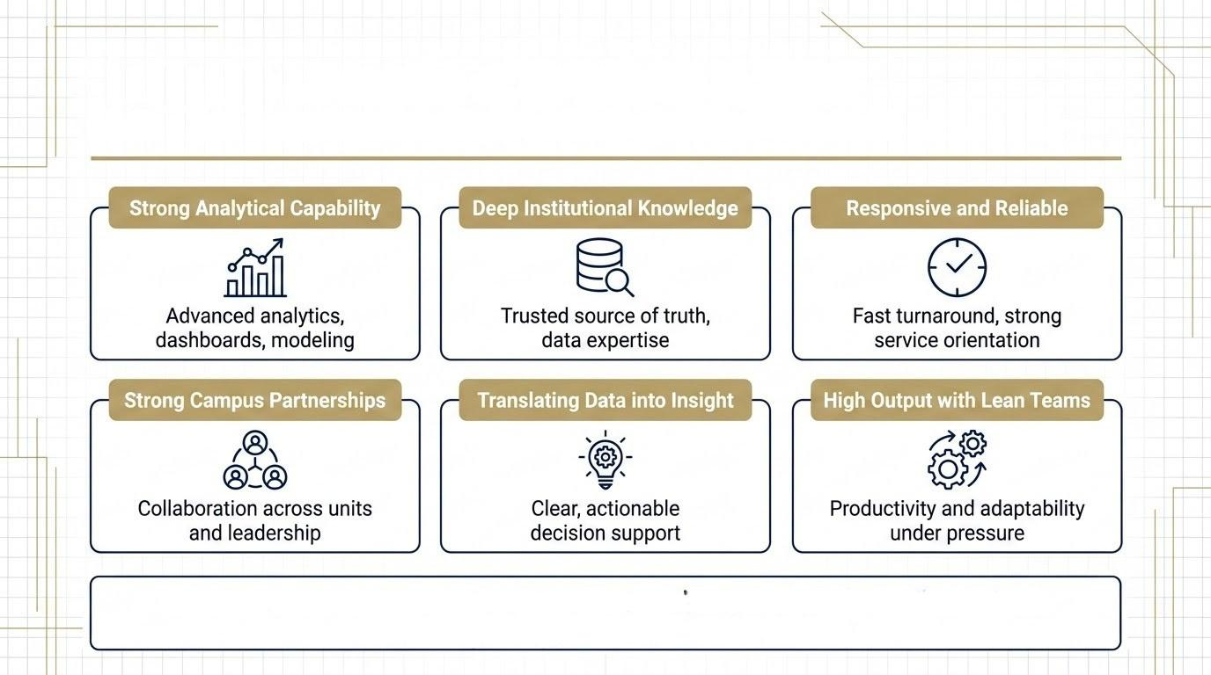
IR in Demand - Emerging Strengths in 2025
IR offices excel at turning complex data into trusted, actionable insight while maintaining strong partnerships across campus.

Slide 14
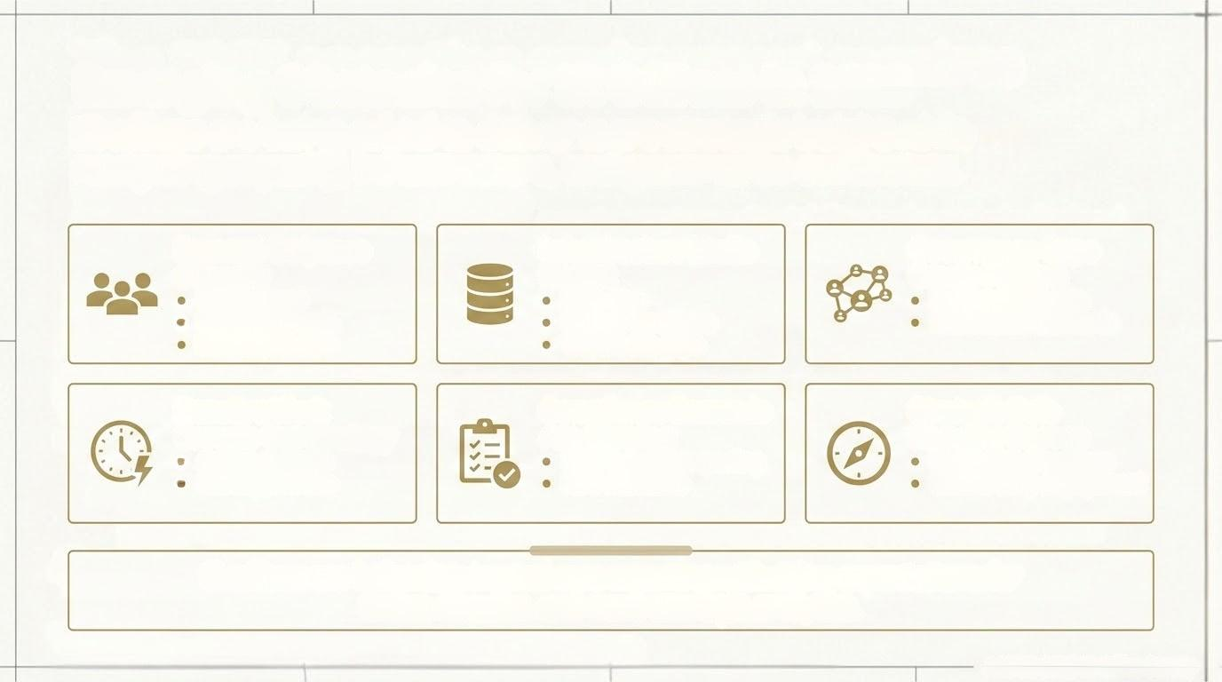
IR in Demand - Emerging Obstacles in 2025
“ I don't know at the beginning of each day what the team is going to be pulled into. Some of it is outside of institutional control, but I worry that we've given up long range planning entirely and that this represents a cultural shift, and we'll never go back to a more meaningful equilibrium…”
Demand Outpaces
Capacity
Infrastructure Limits
Insights
Governance Gaps Create Friction
Staffing gaps
Workload growth
Budget pressure
Data silos
System transitions
Warehouse gaps
Decentralized data
Inconsistent standards
Reactive Work
Crowds Out Strategy
Compliance Demands Are Growing
Not Always at the Strategy Table
Ad hoc requests
Shifting priorities
IPEDS, federal reporting
New mandates
New administrations
Limited early engagement
IR offices are balancing trusted core reporting with rising expectations for faster, broader, and more strategic analytics.

Slide 15
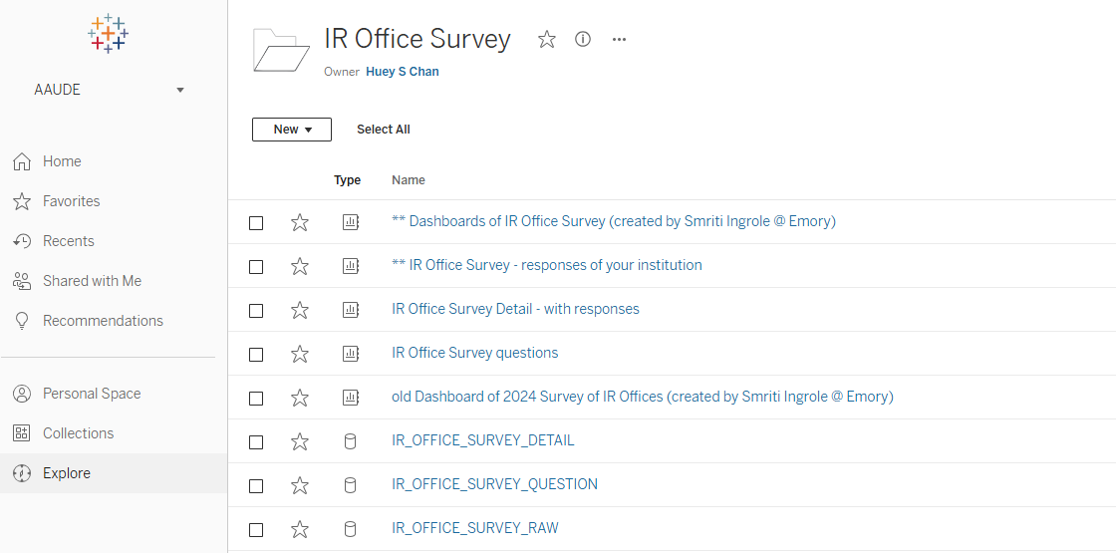
IR Office Survey Dashboard
(https://tableau.mit.edu)

Slide 16
IR Office Survey Detail
(https://tableau.mit.edu)

Slide 17
FEEDBACK AND USE CASES
REQUESTED
How have you used the AAUDE IR Office Survey data, results report, or dashboard?
What would make the survey or dashboard more useful going forward?

