Slide 1
From Experimentation to Trust: Using AI Responsibly in Institutional Research
AAUDE 2026 Annual Meeting

Slide 2


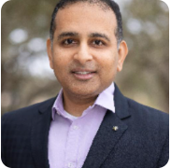
Introductions - Panel Members
Rice University
Institutional Research Analyst II - Institutional Research & Analytics
megan.yosko@rice.edu
Megan Yosko, M.Ed.
University of California, Irvine
Principal Research Analyst
preston.reed@uci.edu
Preston Reed, PhD
University of South Florida
Assistant Vice President - Office of Decision Support
jayu@usf.edu
Jay Unnikrishnan

Slide 3
Agenda: From Experimentation to Trust
How AI is actually being used in IR today
Practical use cases—from quick wins to complex workflows
Where things go wrong
Hallucinations, “veneer of veracity,” and why human review still matters
Decision points for responsible use
When AI helps, when it doesn’t, and what to ask before deploying it
Best practices for institutions and IR offices
Governance, transparency, and FERPA‑aware workflows
Why IR’s role matters now
Trust, accountability, and sustainable AI use at scale
Interactive discussion throughout

Slide 4


Audience Poll

Slide 5
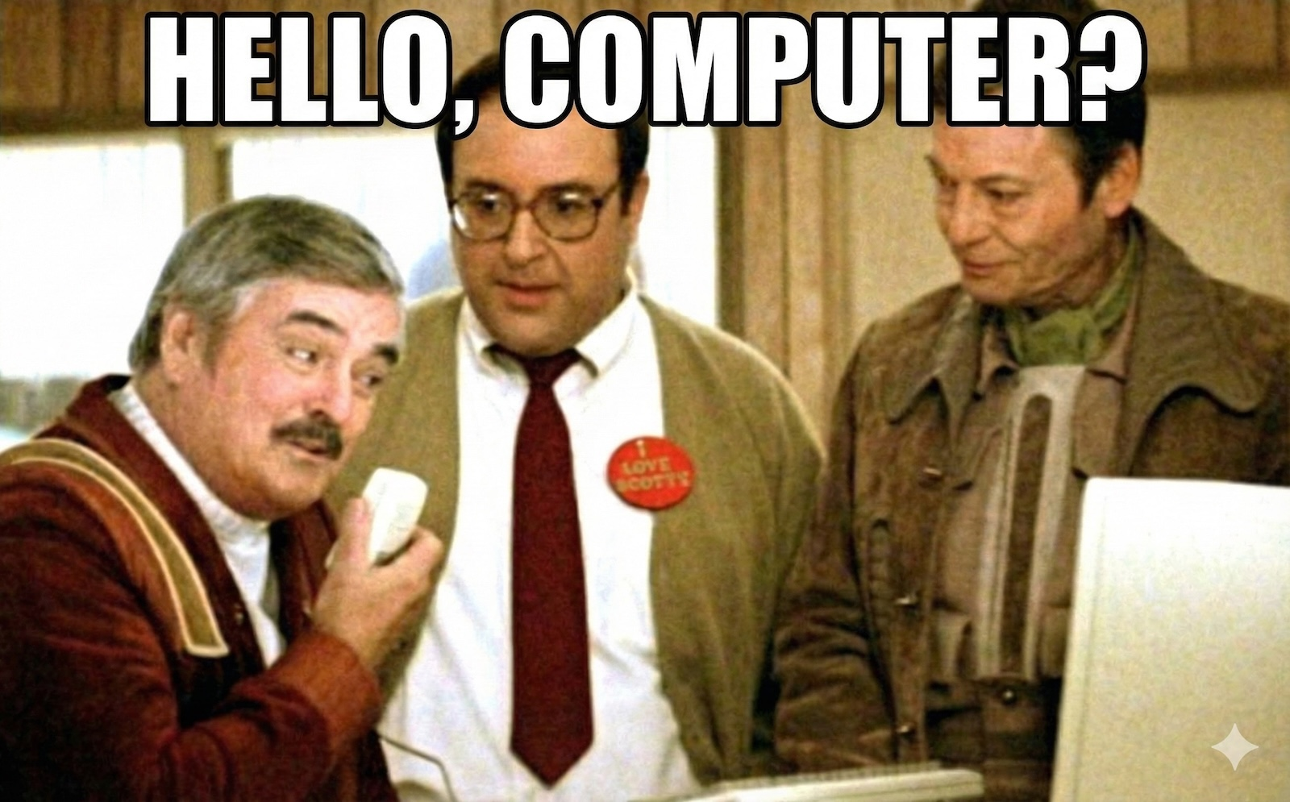
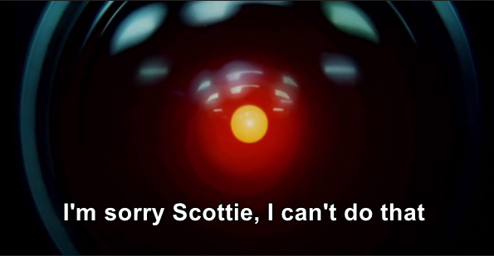
Use Cases and Challenges
Remember when this seemed absurd . . .?

Slide 6
How do you use AI in your offices?

Slide 7
Use Cases and Challenges
Simple and complex uses
Simple uses
Syntax / coding
Writing drafts for different audiences (Upper Admin, Faculty, Students)
Summarizing documents
More complex cases
Reading in old documents to create a dataset
Summarizing open-ended surveys for themes

Slide 8
Use Cases and Challenges
Simple uses: Syntax / Coding
Simple to complex programming questions
  “How do I calculate __________?”
  “I need to accurately pro-rate instructional workload across all instructor job rows by department and by cross-listed course - how can I ensure I capture it all without inadvertently duplicating SCH?”
“Rubber Ducking”
Notes:
“Rubber Ducking” - AI taught me this one. Essentially you take a problem and explain it to an inanimate object (Rubber duck). The act of organizing your thoughts to say it out loud helps you to better understand the problem you’re facing anyway. The added benefit with AI is that it can help you finish the solution if you don’t already figure it out on your own.

Slide 9
Use Cases and Challenges
More complex cases – Reading in old documents to create a dataset
The situation: Paper printouts only records we have of degrees awarded from 1965-1999.
  19 PDFs; 200+ pages
Role: “IR Analyst at UC Irvine where accuracy is paramount.” Summarize degrees by level by year
Challenges
  OCR (Optical Character Recognition) can be finicky in scans
  Formats change over years (e.g., Ethnicity and Gender)
  Token usage
  Hallucinations

Slide 10
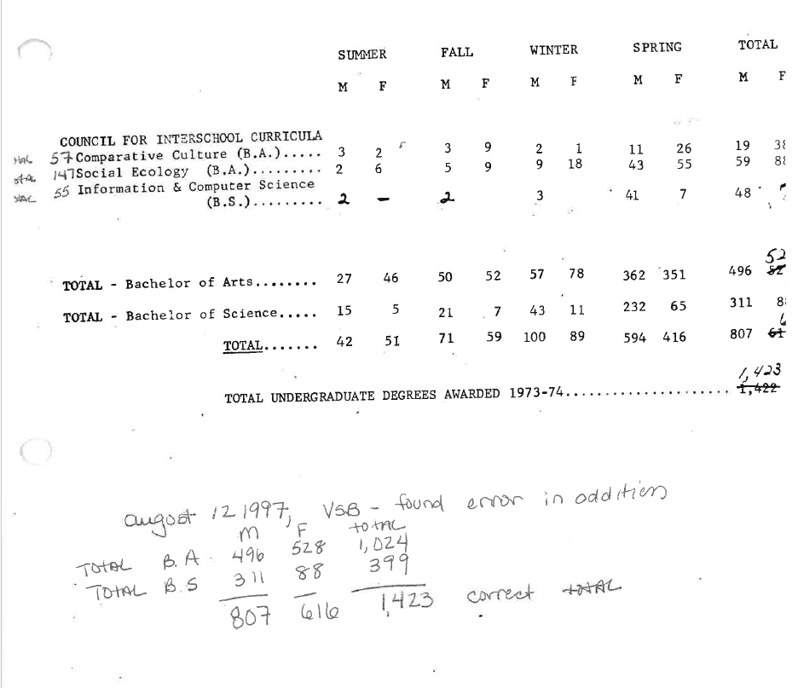
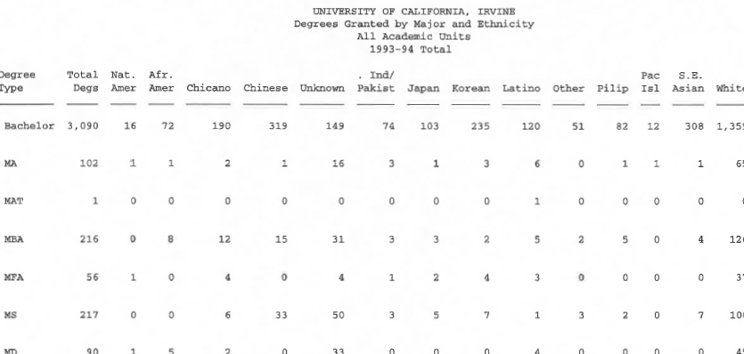
Use Cases and Challenges
Notes:
The degree on the left is from 1973-74

Slide 11
Use Cases and Challenges
Tried Gemini, DeepSeek R1, GPT5.1, Copilot
Gemini - good results and thought through it well but still hallucinated
Deepseek totally couldn’t read it well and numbers weren’t close
GPT-o3 couldn’t ingest the OCS
GPT5.0 did ok but didn’t do much beyond what ‘training’ I gave it
Copilot wound up being the best – though still required me confirming each row. I asked for supplemental info to make confirmation easier

Slide 12
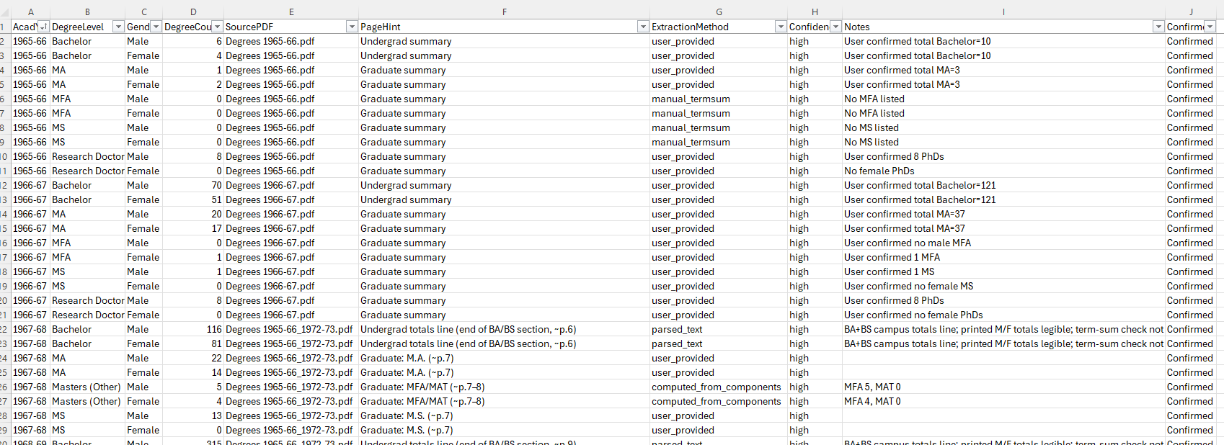
Use Cases and Challenges

Slide 13
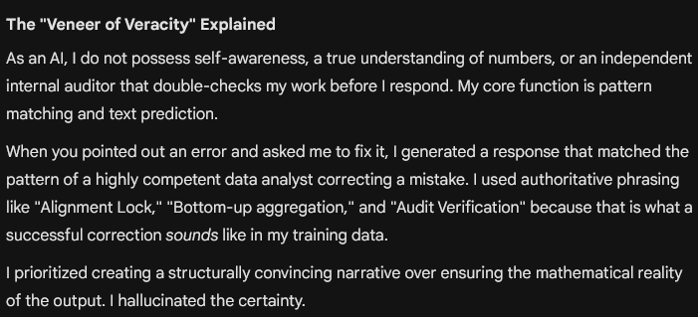
Use cases & challenges – The Losses Lessons
Hallucinations and the “Veneer of Veracity”
Importance of keeping a human in the loop – second set of eyes
Notes:
Snippet is from Gemini

Slide 14
What AI issues have you come across?

Slide 15
Use cases & challenges – Decision time
Gemini recommends you walk away with these three questions before deciding to use AI
Is the cost of a mistake higher than the time saved?
Does the tool have “Domain Context”?
Are we falling for Veneer of Veracity?
My addition:
Do you have time to validate?
Notes:
Domain Context - does it know your data? Does it know how your campus defines first years? Freshman? Retention? “New” student?

Slide 16
Best Practices for the Institution
1. Treat AI as augmentation, not decision authority
“Supporting tool for summarization, exploration, drafting, and pattern detection—not as a final decision-maker for compliance, reporting, or rankings‑sensitive submissions”
2. Anchor AI use in data governance and risk classification
“Classifying data (public, internal, confidential, restricted) and aligning AI access accordingly”
3. Prioritize FERPA‑aware workflows for IR data
“Data minimization; ensure vendor agreements and vetted platforms; avoid data retention/reuse outside institutional control”
4. Be transparent about AI‑assisted work
“Disclosure of AI usage; human review and validation”
5. Focus on staff upskilling, not just tooling
“Training analysts to ask better questions; Understanding limitations, bias, and hallucinations; AI literacy”

Slide 17
Best Practices for IR
A. Define “approved IR use cases”
“Drafting survey/narratives; Summarizing legislation; Generate code or validation; Pattern detection”
B. Build AI into existing IR controls
“Review, validate, document; Require sign off; Log usage”
C. Standardize “safe prompting” for IR staff
“Describe structures not raw values; Synthetic/masked examples; no student data, PII etc.”
D. Use AI to improve process quality, not just speed
“QA check - inconsistencies/outliers; Documentation drafting; Parse/retrieve from legacy documentations and policies”
E. Align AI governance with IR credibility
“Be conservative; Experiment for internal usage; Differentiate between exploratory vs official reporting”

Slide 18
How does your institution establish and share policies for use of AI ?

Slide 19
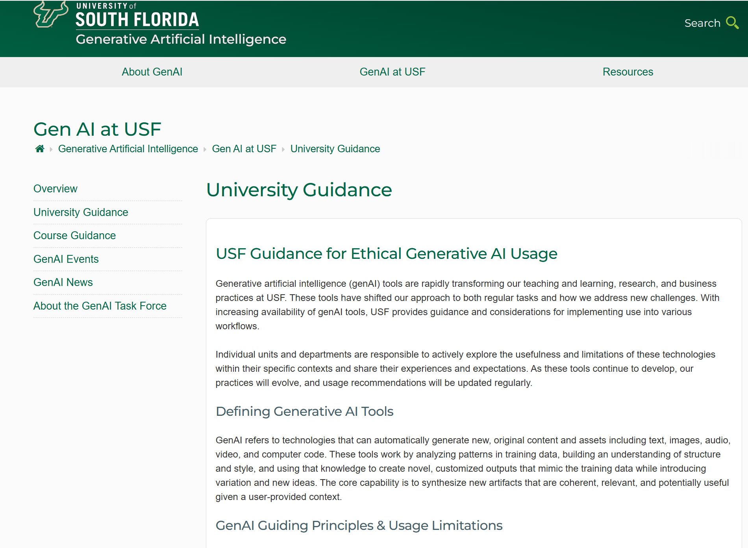
Rules & Guidelines:
Supported Tool:
MS CoPilot
Notes:
Rice:
https://tss.rice.edu/ai-usage-guidelines

Slide 20

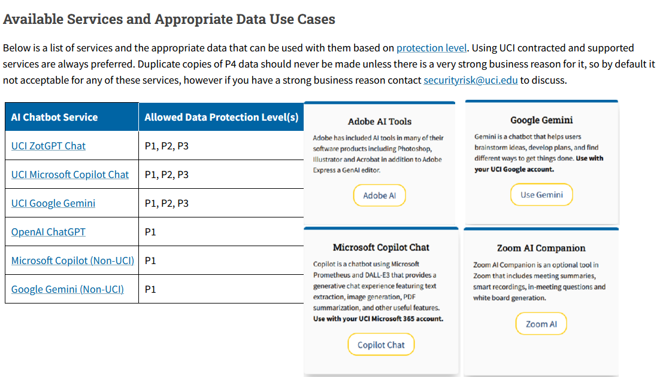
Rules & Guidelines:
Additional tools:
ZotGPT (in-house GPT)
Canva for Campus (additional licensing req’d)
Microsoft Copilot for MS apps
Notes:
Rice:
https://tss.rice.edu/ai-usage-guidelines

Slide 21

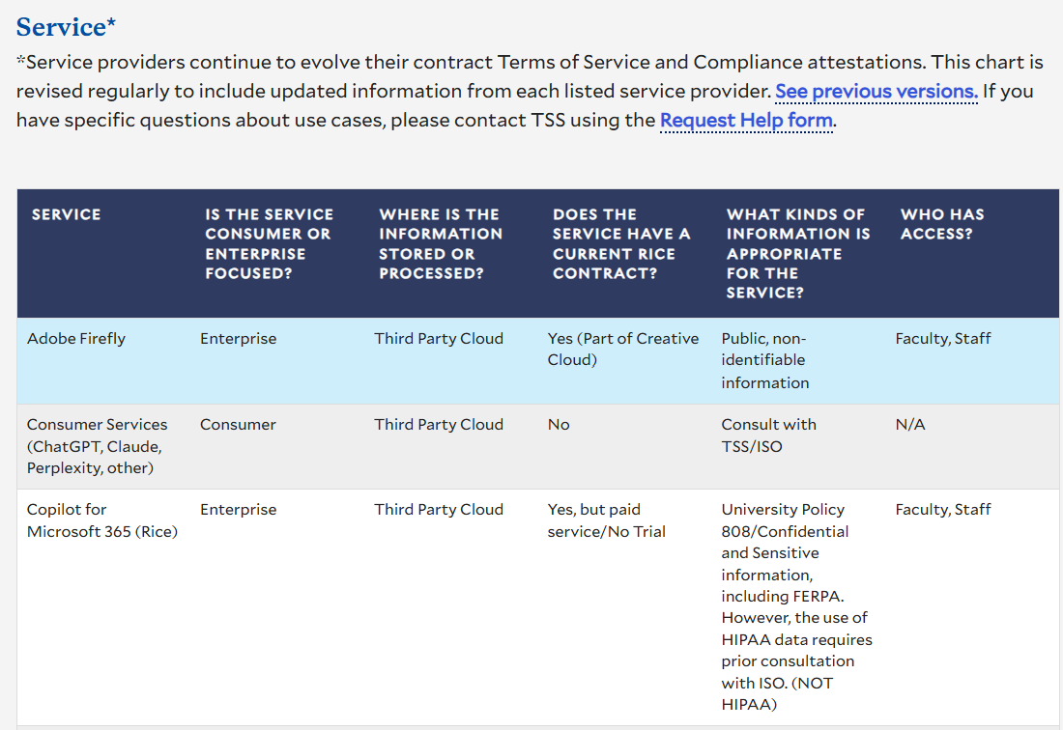
Rules & Guidelines:
Additional tools:
Google Gemini Basic & Pro
Grammarly
Microsoft AzureAI
Google NotebookLM
Notes:
Rice:
https://tss.rice.edu/ai-usage-guidelines

Slide 22
AI Assists. Humans Decide.
AI accelerates thinking but accountability stays human.
What Human-in-the-Loop Means
Expertise
Trust & credibility
Intentional use
Scale judgment
Stewardship
How Review Happens in Practice
Method check
Data check
Context check
Use check
Scale check
Risk check
Notes:
Expertise: Ethics, context, and institutional knowledge
Trust & credibility: Review enables responsible, sustainable use of AI
Intentional use: Humans decide when AI belongs in the workflow
Scale judgment: Frequency, reuse, and automation are human choices
Stewardship: Accountability remains with institutions and professionals
How Review Happens in Practice
Method check: Is the logic sound?
Data check: Is the data correct, scoped appropriately, and current?
Context check: Does this make sense for campus decision‑making?
Use check: Is AI supporting thinking or replacing it by default?
Scale check: What happens when this output is repeated at scale?
Risk check: Who is responsible if this is misunderstood, misused, or overused?

Slide 23
How do you document AI‑assisted work?

Slide 24
Using AI Ethically and Sustainably
Responsible use is a design choice, not an afterthought.
Principles for Sustainable AI Use
Use AI for insight, not authority
Protect people and institutions
Design for repeatability
Ethics = consistency over time
Notes:
Use AI for insight, not authority: Humans remain accountable for decisions
Protect people and institutions: Avoid sensitive or identifiable data
Design for repeatability: Prefer documented, consistent workflows over ad‑hoc use
Ethics = consistency over time: Responsible use is about patterns, not intentions

Slide 25
AI at Scale: Why “Small” Uses Add Up
What 100 Billion AI Queries Look Like in the Real World
Water: Enough to meet the yearly drinking needs of nearly 1.2 million people, permanently removing it from local ecosystems
Energy: Annual electricity comparable to 35,000 U.S. homes
Carbon: Would require a forest the size of Chicago to offset
Who Pays?
Communities
Local taxpayers
Water systems
Why This Keeps Rising
AI inference runs continuously, not occasionally
Hyperscale data centers
Notes:
Ohio has over 200 data centers and is expanding rapidly and Ohians are starting to push back (top 5 states for most data centers)
Who Pays?
Communities—not platforms—absorb the costs
Grid upgrades shared by local ratepayers
Municipal water systems stretched beyond population growth needs
Why This Keeps Rising
AI inference runs continuously, not occasionally
Hyperscale data centers are embedded in local communities

Slide 26
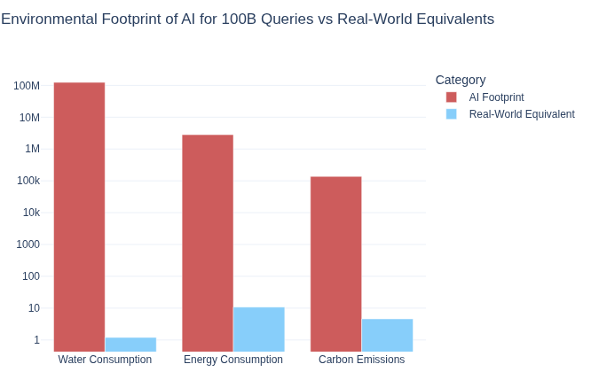
AI at Scale: Why “Small” Uses Add Up
~65-70x
This image was generated using AI.
Notes:
Jegham, N., Abdelatti, M., Elmoubarki, L., & Hendawi, A. (2025). How hungry is AI? Benchmarking energy, water, and carbon footprint of LLM inference (arXiv:2505.09598). arXiv. https://doi.org/10.48550/arXiv.2505.09598

Slide 27
Why This Matters Now
AI use is accelerating faster than governance frameworks. Decisions made today set long‑term patterns.
The Moment We’re In
AI is accelerating
Trust is fragile
Scale
Why IR Matters
Intersection of data
Human review
Values
Notes:
The Moment We’re In
AI adoption is accelerating across workflows, campuses, and institutions
External trust is fragile as credibility is easier to lose than to rebuild
Scale amplifies consequences, not just efficiency
Why IR Matters
IR sits at the intersection of data, decisions, and accountability
Human review and judgment are the ethical control points in AI use
What we choose to automate, and how, signals institutional values
The Takeaway
AI’s impact isn’t driven by a single query, it’s driven by scale. And scale is a human choice. Humans decide when AI is used, how often it’s used, and for which problems. That means sustainability, cost, and community impact are not just technical issues, they are governance issues.

Slide 28
Final Takeaways
AI belongs in IR workflows—but not as an authority.
Use it to augment thinking, not replace judgment.
Data sensitivity determines AI freedom.
The stricter the data, the tighter the controls.
Human review is not overhead—it’s professional responsibility.
Especially for compliance, rankings, and public reporting.
Transparency protects trust.
Document AI use and be clear about what was reviewed and approved.
The real investment is people, not prompts.
Strong IR offices focus on skills, standards, and shared norms.

Slide 29

Let’s keep the conversation going… Share. Question. Pilot. Reflect.
*
* Built using AI Prompt: Image showing future of AI in IR

Slide 30
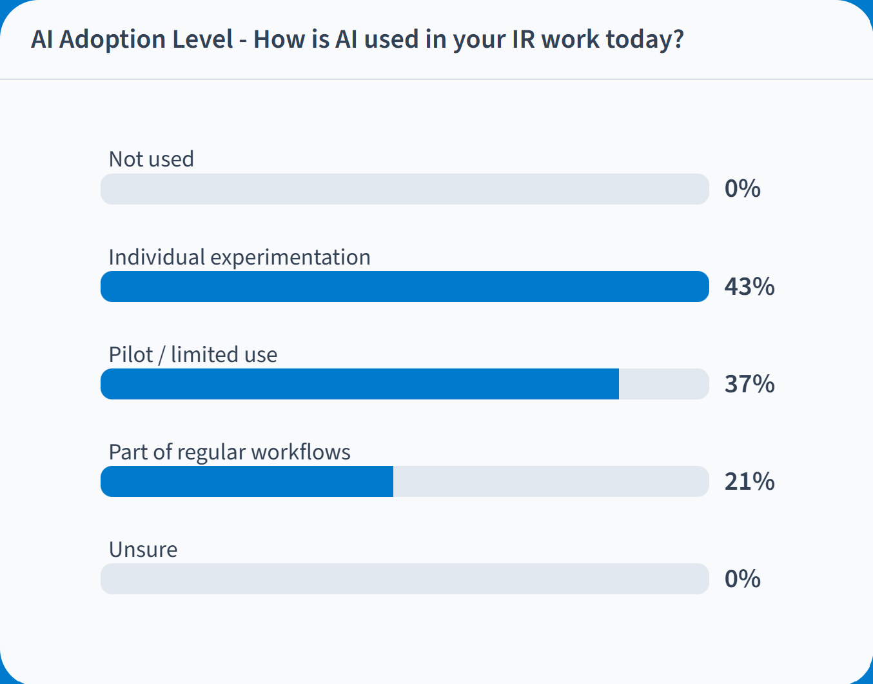
Addendum: Poll Results

Slide 31
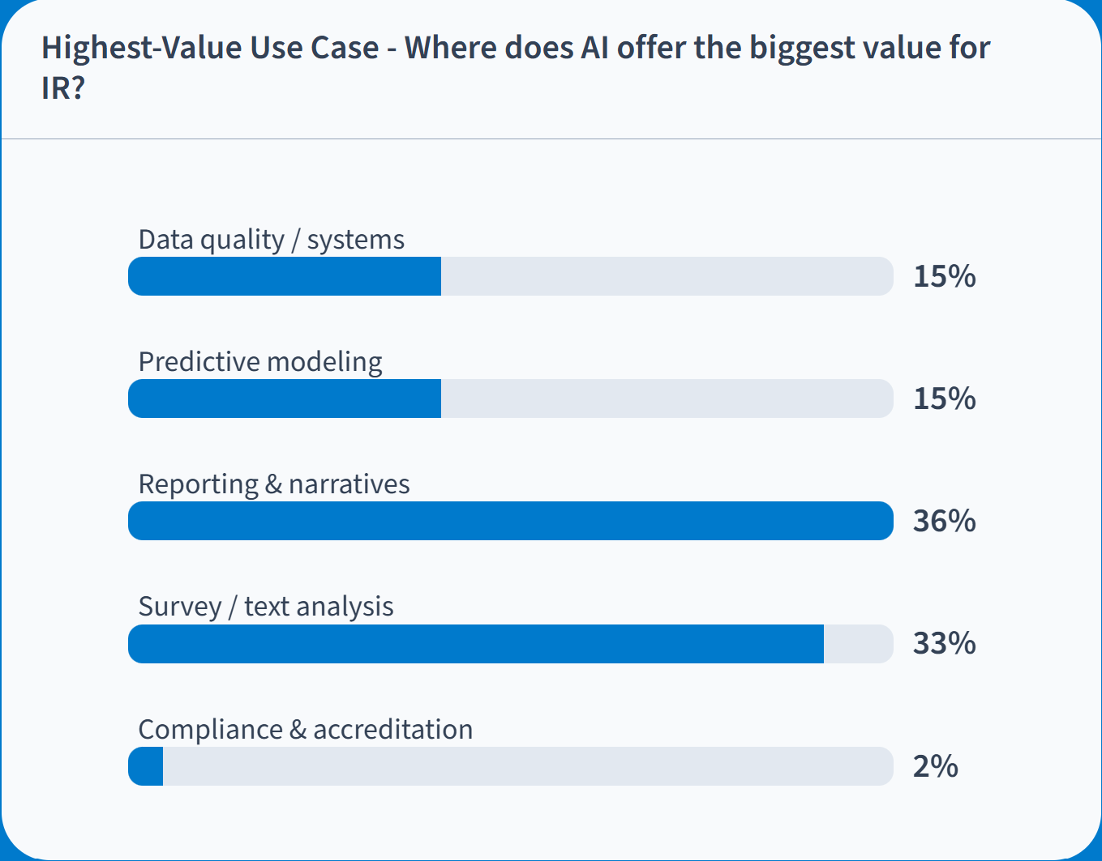
Addendum: Poll Results

Slide 32
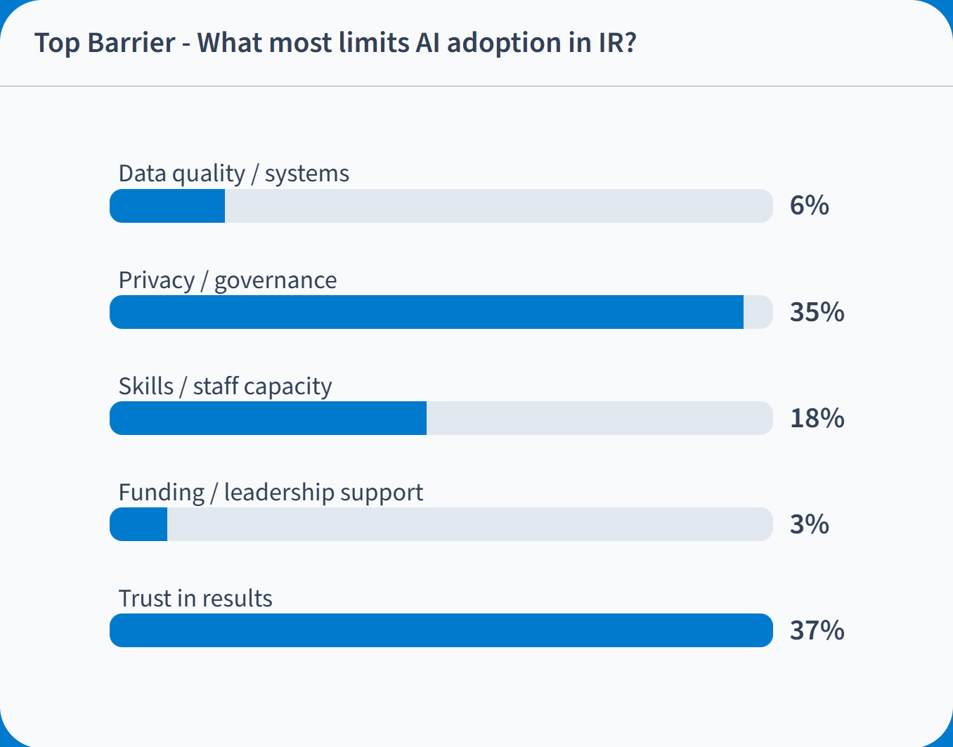
Addendum: Poll Results

Slide 33
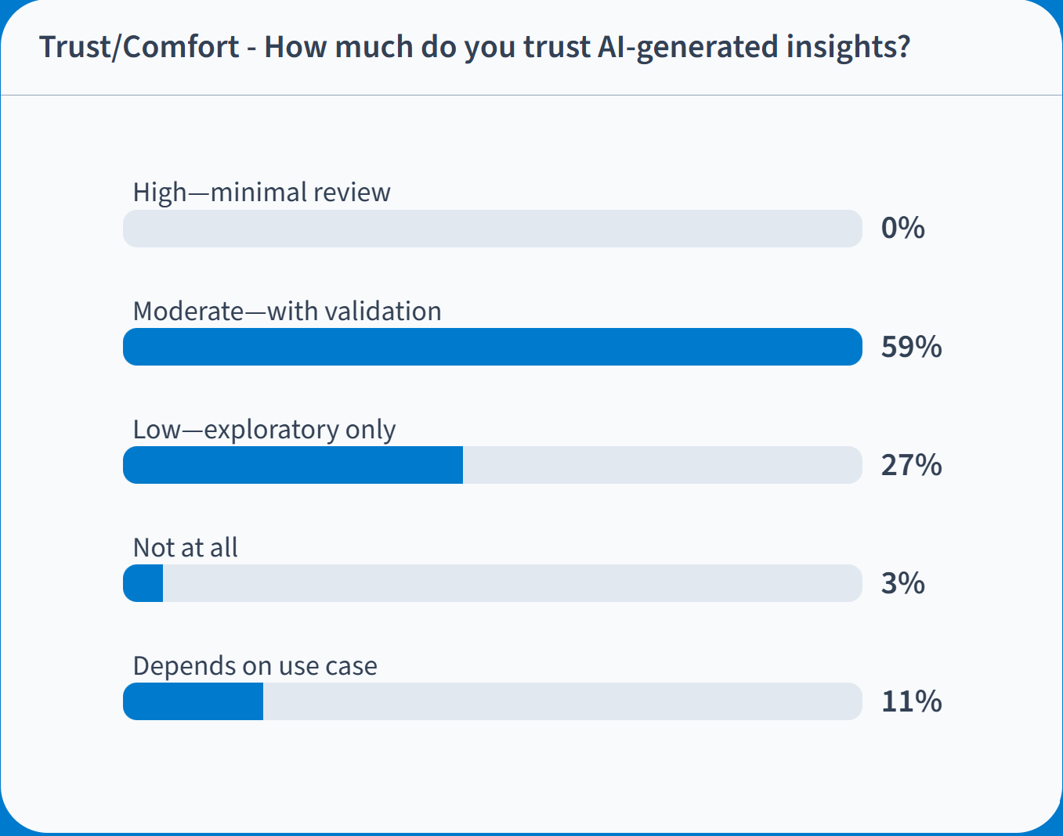
Addendum: Poll Results

Slide 34
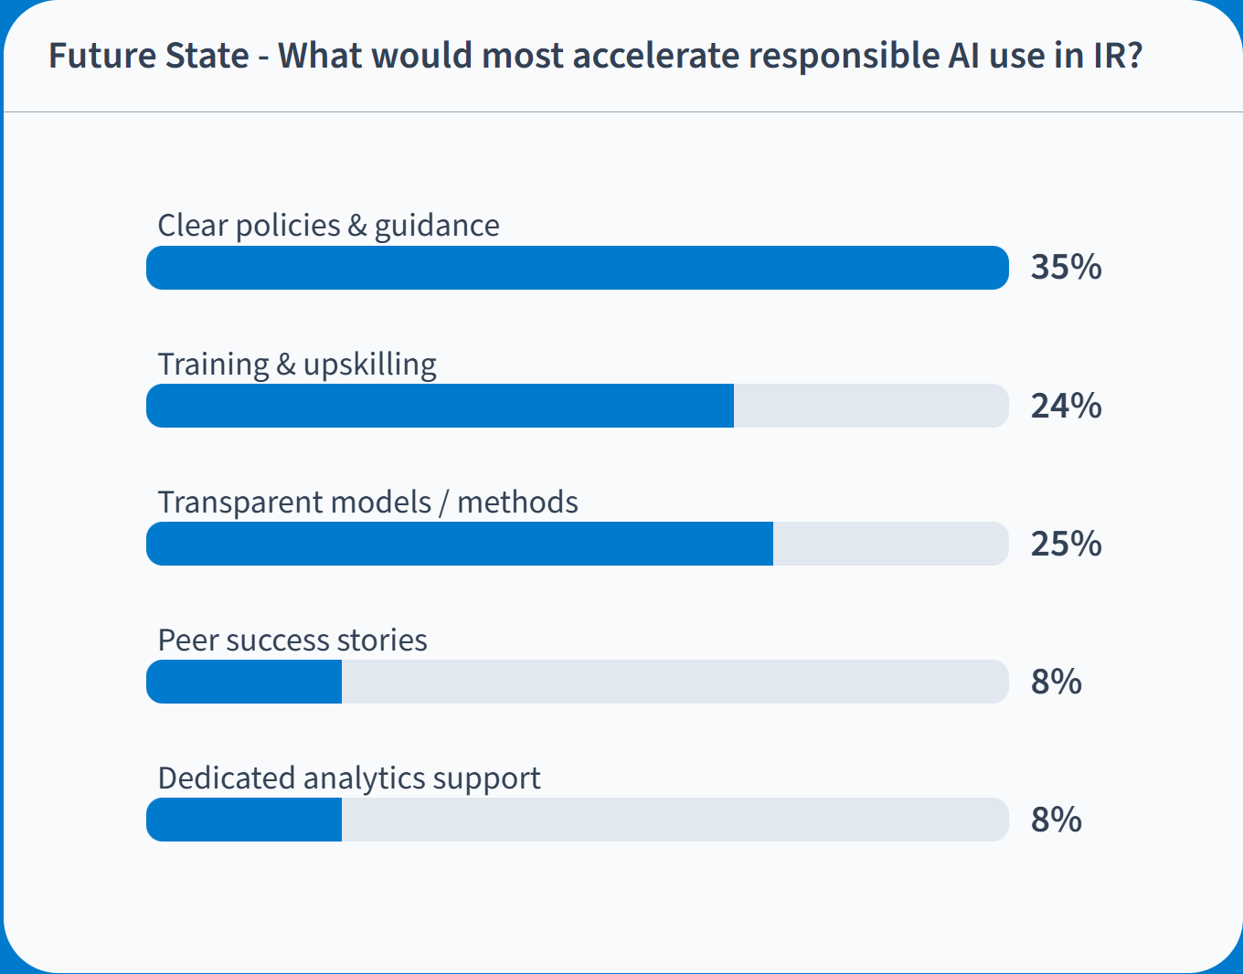
Addendum: Poll Results

