Slide 1

Revitalizing the AAUDE
Ad Hoc Data Exchange
2026 AAUDE Annual Meeting
Houston Texas
Weini Chen, AAUDE / MIT
Linette Decarie, Boston University
Christy Witt, Rice University

Slide 2

Council Request:
Need for Change
Core to Mission: AAUDE is, by definition, a data exchange, and the ad hoc exchange is at the core of its mission.
Critical Utility: Ad hoc requests are vital for peer benchmarking and institutional decision-making.
Declining Participation: Despite the high value, participation has dropped in recent years.
Increasing Complexity: Requests have become more complex, while existing processes remain manual and burdensome.
Sustainability Concerns: Current workflows and communication are clunky, not standardized, and too laborious to be sustainable for IR offices.

Slide 3
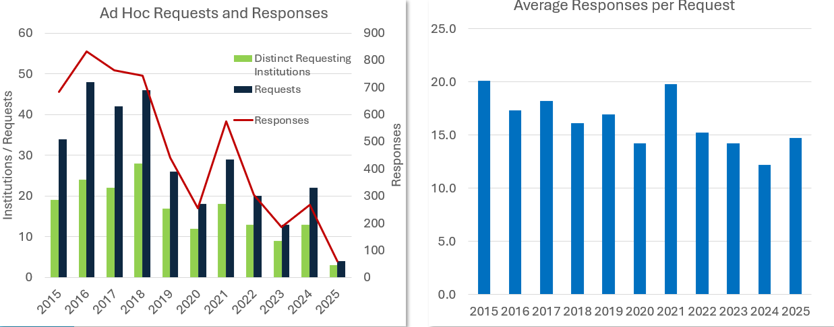
Decline in Use

Slide 4
Working Group Scope & Methodology
The Charge
End-to-End Review: Analyzed the entire process from request origination to summary archiving.
Member Feedback: Gathered insights at the 2025 Annual Meeting and through individual conversations.
Benchmarking: Evaluated practices of peer consortia like the Big Ten and G14.
Pain Point Identification: Targeted inefficiencies in workload, compliance, and data interpretation.

Slide 5

Working Group Composition
Linette Decarie, Boston U, Committee Chair
Dave Becher, U Miami
Weini Chen, AAUDE
Mark Chimel, Carnegie Mellon U
Michele Matouka, U Michigan,
Chen Shen, Boston U
Christy Witt, Rice University

Slide 6

Pain Points
Barriers to Engagement
Process Burden: Manual templates and formatting are perceived as "high effort, low benefit".
Searchability Issues: Limited tagging (single category) makes it hard to find historical data.
Compliance Fears: Concerns regarding sensitive data and appropriate use by General Counsels.
Format Inconsistency: Mix of Word, Excel, and Qualtrics complicates data cleaning.
Steep Learning Curve: New members struggle to onboard without specific training.

Slide 7

Recommendation: A Custom Web-Based Solution
Moving Away from Manual Workflows
The Goal: A custom web application integrated with the AAUDE data warehouse.
Why Custom? Avoids reliance on vendor-specific platforms (Qualtrics, Google) while allowing for specific AAUDE tailoring.
Key Design Pillars:
  Accessibility: Browser-based with MIT Kerberos Single Sign-On
  Standardization: Form-based submissions.
  Automation: Notifications, tracking, and real-time summaries.
  Flexibility: Multiple tags per request and audience filtering.
  User-Friendly: Save drafts, edit submitted data.

Slide 8
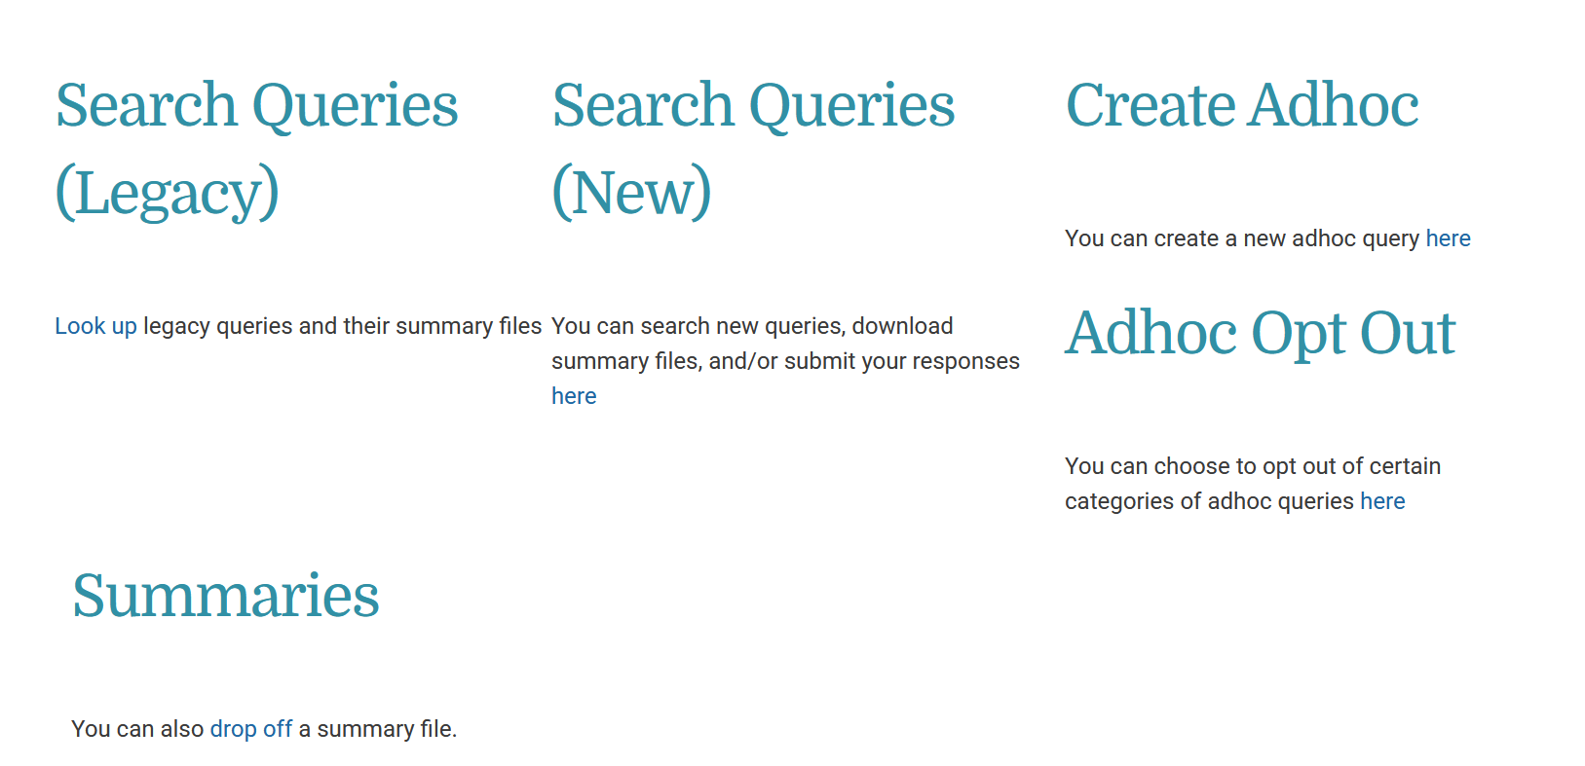
Ad Hoc Summary Application
New queries will be searchable in data warehouse
Access to legacy query library is maintained
Creating, distributing, and uploading summaries will be obsolete
New queries will be searchable in data warehouse, and summary results can be downloaded
Opt out of receipt of requests based on topical category

Slide 9
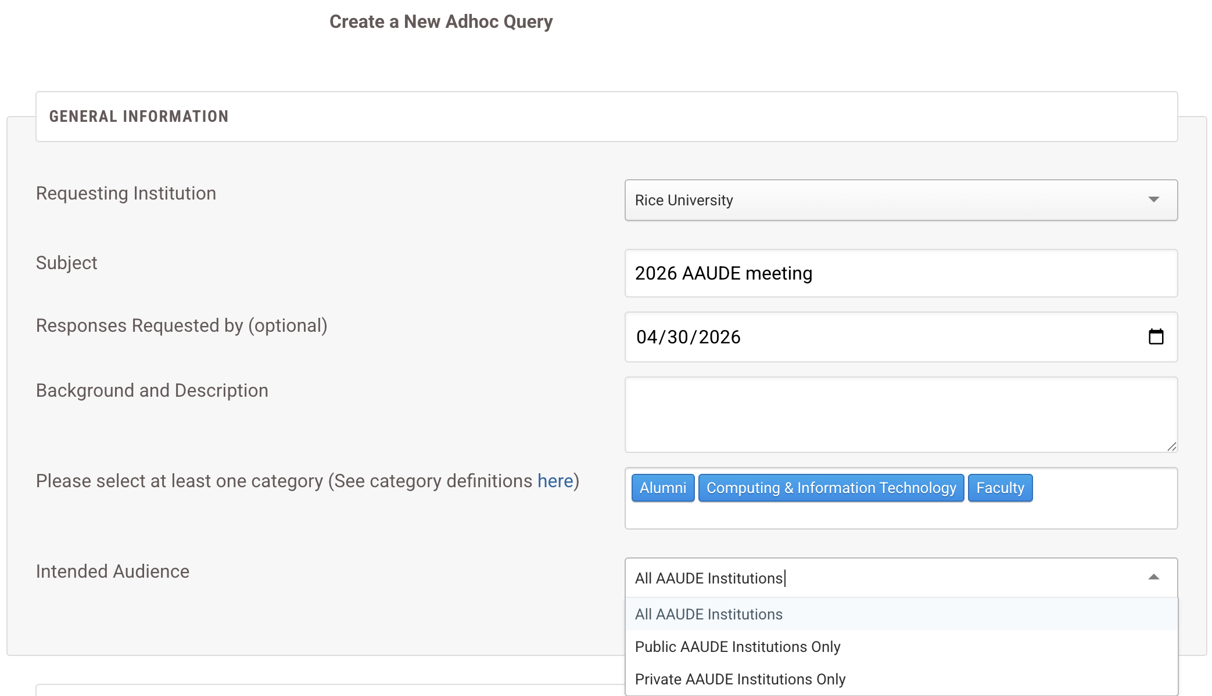
Demonstration: Request Metadata
Institution
drop-down
Request description fields
Multiple tagging option
Audience Selection

Slide 10
Category Tags
Category tags enable quicker searching and topic review
Members can opt out of requests based on tags
Category Name | Definition | Example
Academic Programs & Instruction | Academic offerings and instructional activity of the institution. | Degree and certificate programs, course curricula, instructional delivery, academic standards.
Administration, Management and Policy Misc. | Central governance and administrative oversight functions. | Executive leadership, policy development, strategic planning, institutional governance.
Alumni | Engagement and information related to former students. | Alumni relations, communications, events, alumni giving and fund-raising.
Appropriations & Funding | Institutional funding sources and allocations. | State or federal appropriations, grants, gifts, internal funding distributions.
Computing & Information Technology | Technology systems and IT services supporting institutional operations. | Enterprise systems, networks, data infrastructure, cybersecurity, IT support.
Costs & Expenditures | Institutional spending across functions and units. | University expenses such as instructional expenses, administrative costs, auxiliary expenditures.
Crosswalks | Definition TBD. | Examples TBD.
Enrollment, Student Credit Hours, etc. | Measures of student participation in academic activity. | Headcount enrollment, FTE, student credit hours, enrollment status.
Faculty | Information related to instructional and research faculty. | Faculty counts, rank, appointment type, workload, demographics.
Finances (General) | Overall financial condition and activity of the institution. | Revenues, assets, liabilities, reserves, financial ratios.
Minorities/Diversity | Demographic diversity data used for analysis and reporting. | Race/ethnicity distributions, gender representation, equity indicators.

Slide 11
Category Tags
Category Name | Definition | Example
NRC | Information related to National Research Council evaluations. | NRC information.
Peers | Definition TBD. | Examples TBD.
Personnel | Workforce employment and staffing information. | Staff counts, job classifications, turnover, employment status.
Ranking | Definition TBD. | Examples TBD.
Reporting (External), IPEDS, Surveys | Data prepared for external accountability and benchmarking. | IPEDS submissions, accreditation reports, government reporting, other external surveys.
Research | Sponsored and institutional research activity. | Research expenditures, grants and contracts, compliance reporting.
Retention, Graduation & Degrees Awarded | Student progression and completion outcomes. | Retention rates, graduation rates, time-to-degree, degrees awarded.
Students | Student-related data beyond enrollment counts. | Demographics, academic standing, financial aid, engagement indicators.
Tuition, Fees & Other Charges | Charges assessed to students for education. | Tuition rates, mandatory fees,and program-specific charges.
AAUDE members are encouraged to recommend additional tag options
Public salary data tags are in discussion. Suggestions on which tags would be most useful for opt-in/out are appreciated!

Slide 12
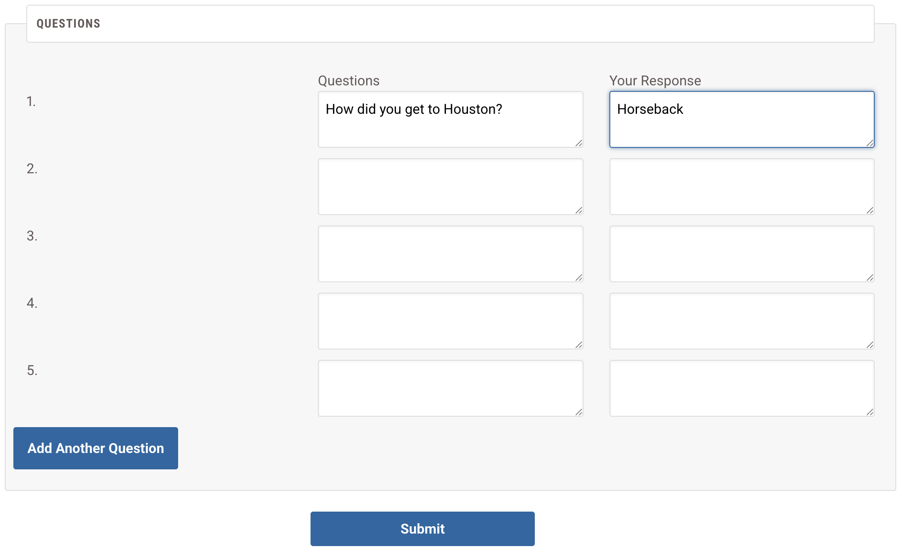
Demonstration: Question Form
Required requestor answer entry
Multiple question input
Add additional questions as needed
We are exploring addition of alternative question types such as pre-filled responses, multiple choice, and radio buttons.

Slide 13
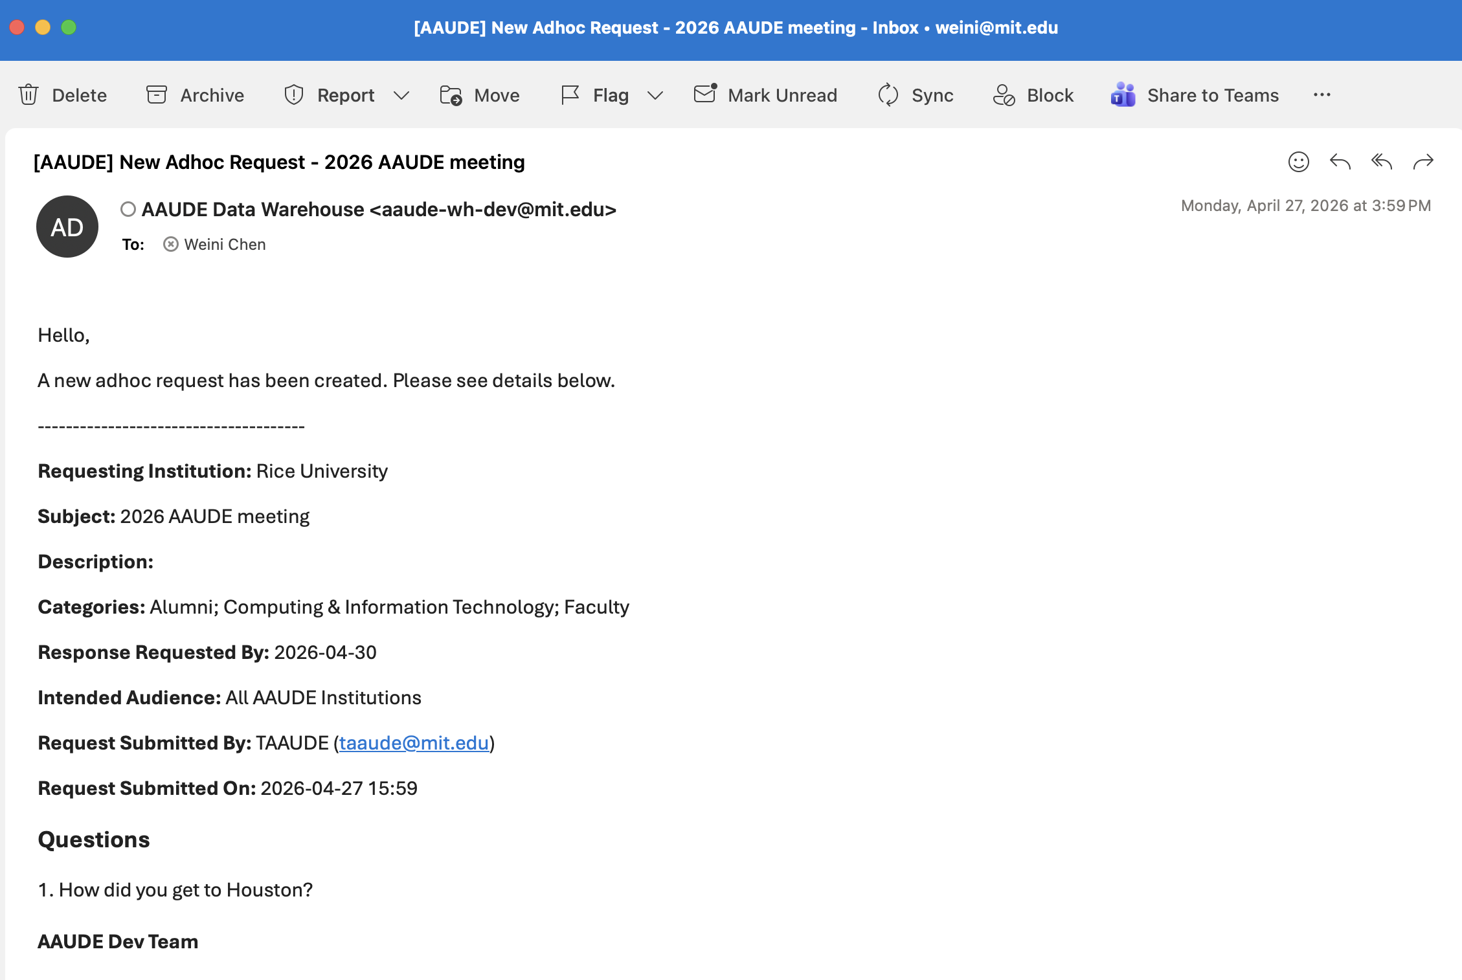
Demonstration: Request Email Notification
Once created, the request will be sent as an email notification to a set of recipients based on the ”audience” the requester specified, and each institution’s “opt out” choices.
*Will add additional details to the email content, e.g., the request’s URL

Slide 14
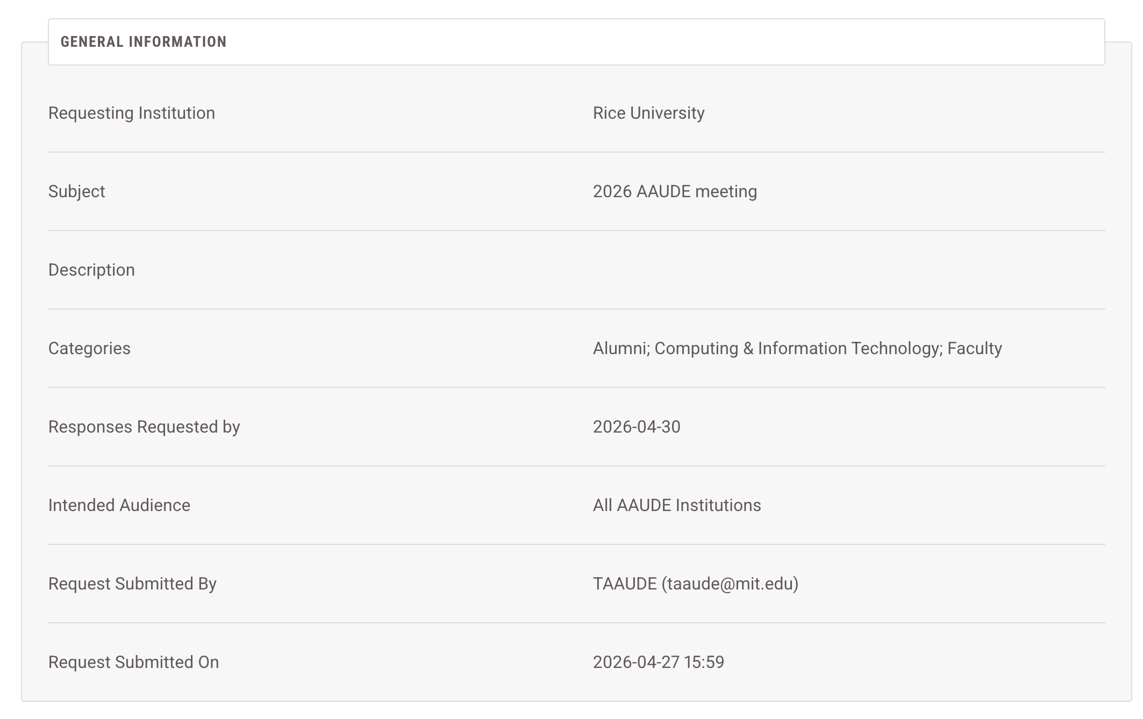
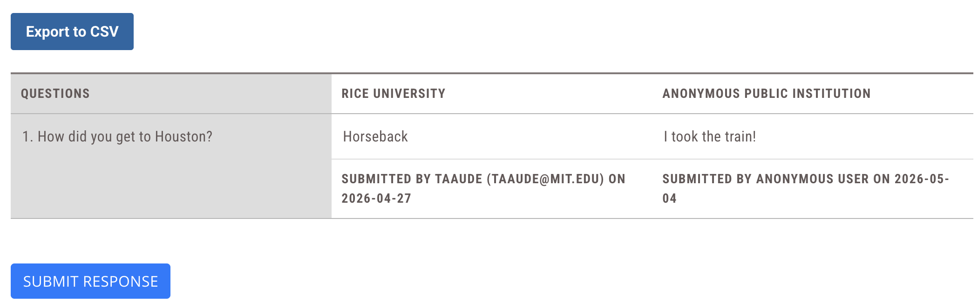
Demonstration: View Request and Responses
General information / metadata
Confidentiality selection automatically masks institution and submitter names in summary
Export data option available for use and appropriate sharing
See next slide for response submission
*AAUDE membership / login required to submit final response.

Slide 15
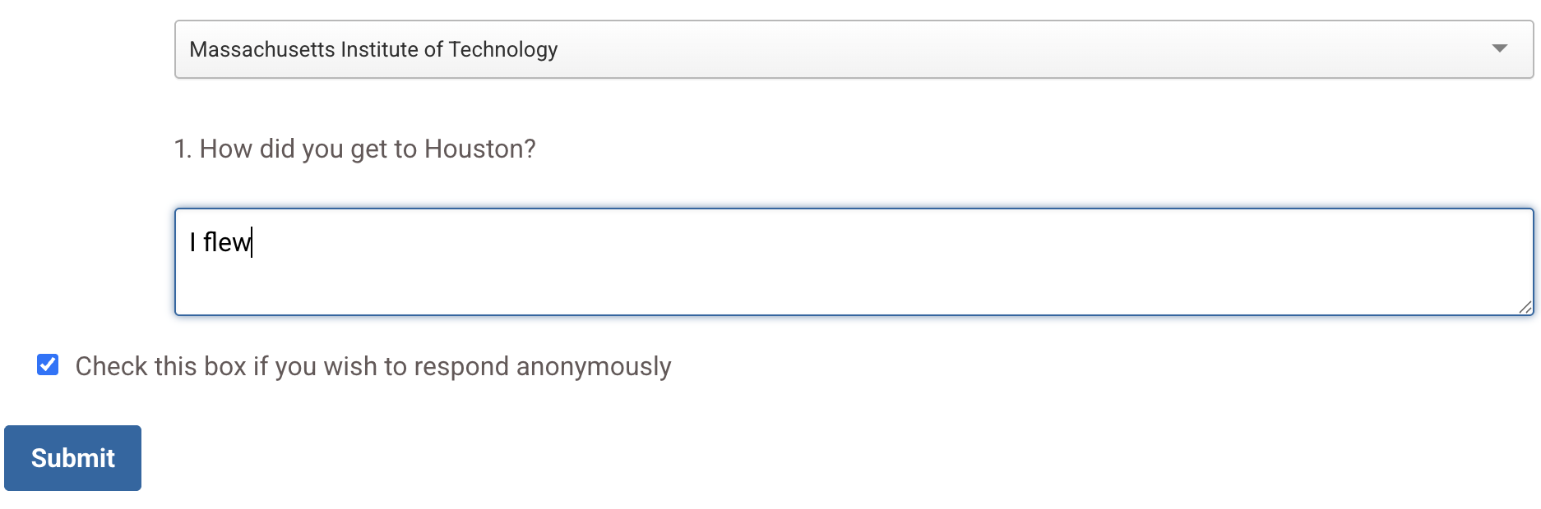
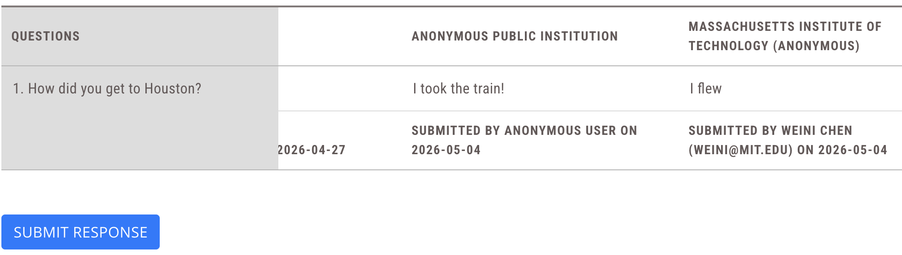
Demonstration: Respond to a Request
Confidential option automatically masks the institution’s name and submitter info in summary to other institutions
Institutions that chose the “confidential” option have names masked
Your own institution’s response are visible to you even if marked anonymous

Slide 16
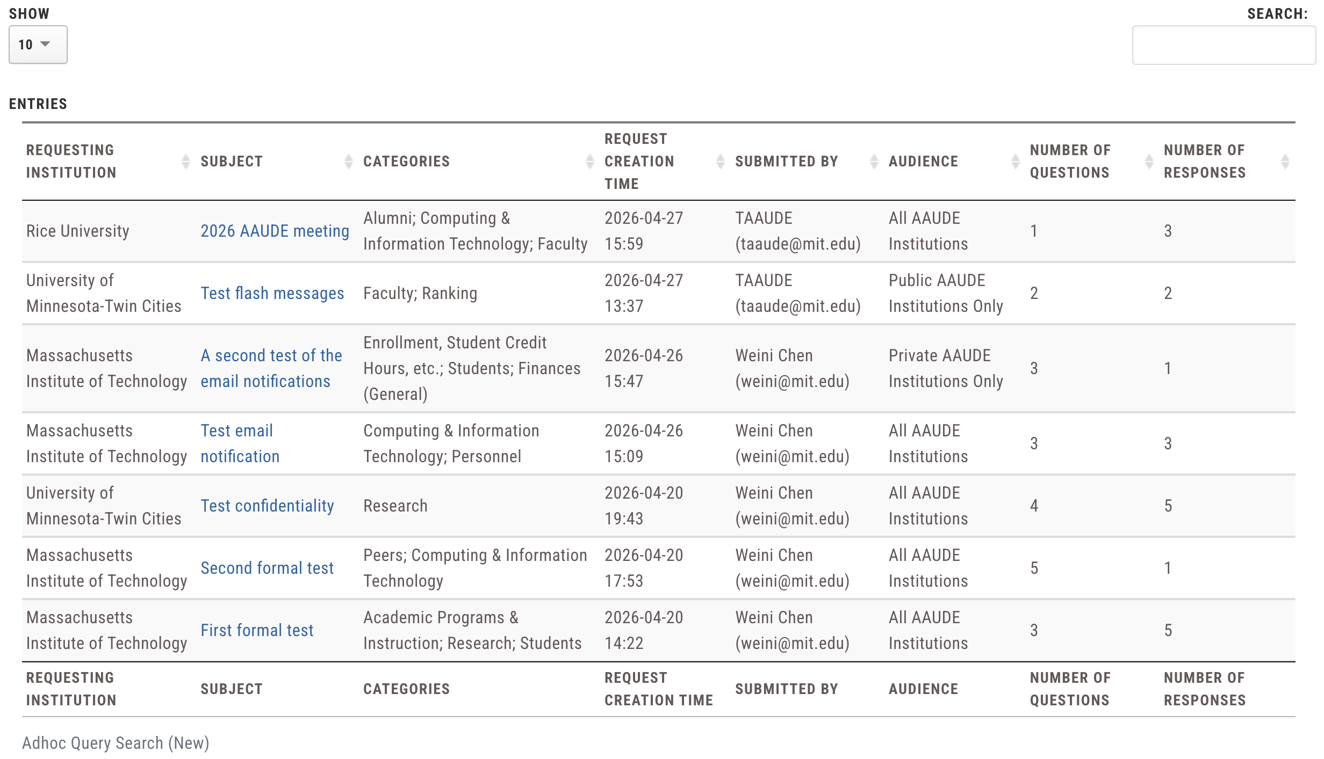
Demonstration: Request Library
Request and responses immediately added to Library
*Will build more robust search functionality

Slide 17
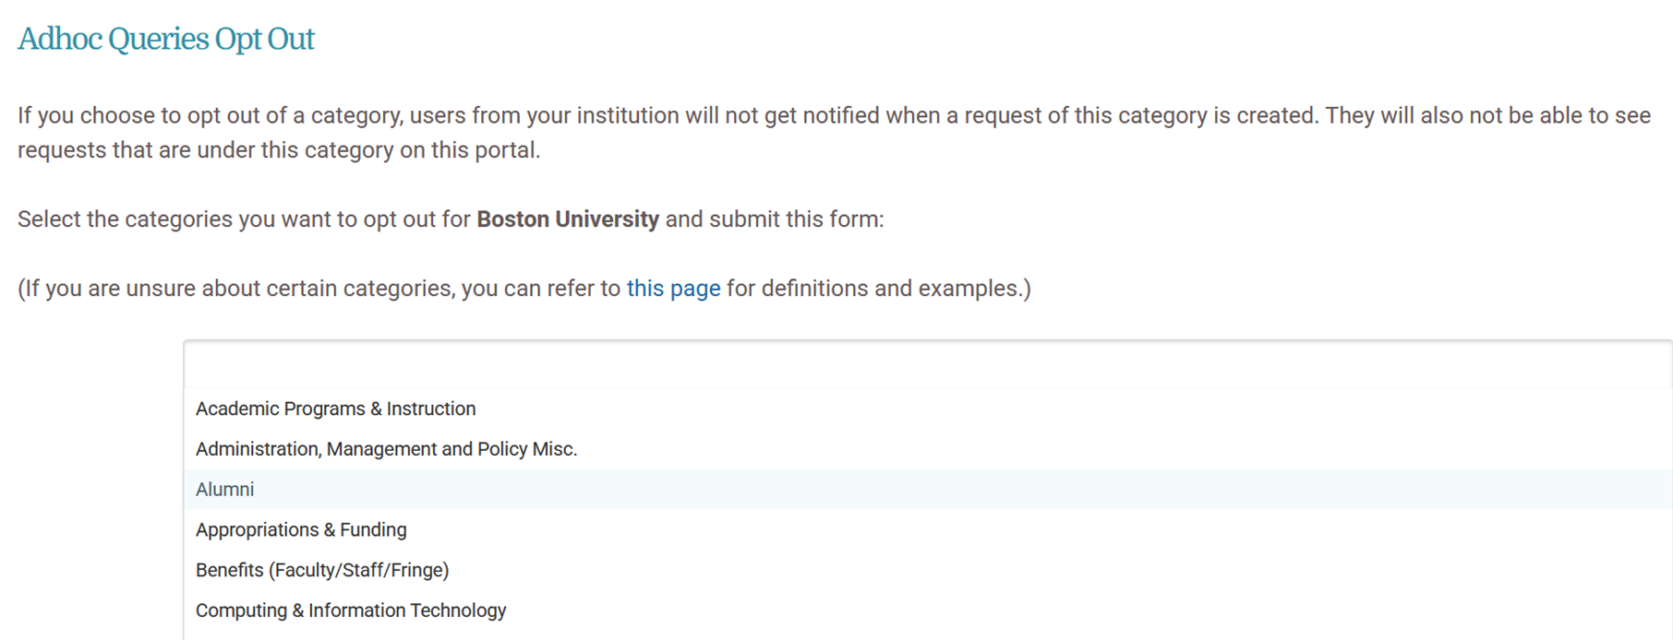
Demonstration:
Query Opt Out
Primary representatives can opt out of queries in various categories based on the needs of their organization

Slide 18

Process Update: Limiting Salary Exchanges
The Ad Hoc Exchange can no longer be used for soliciting information about salaries, benefits, or other financials related to employment unless the information exchanged is publicly available.
Watch for communications in the coming months for updates on migration and stewardship of ad hoc requests that might include non-public information on salary, benefits, tuition, etc.

Slide 19
Beyond Technology:
Communication Enhancement
The new exchange process attempts to revitalize AAUDE’s exchange culture by:
Reducing the manual burden associate with the current exchange process through exchange template format and data summaries.
Limiting sensitive and prohibited content through distribution opt-out by category and limitation of exchange of salary and benefit information.
Providing on-demand response exports with automatic masking of institutions that choose confidentiality. Reponses are assumed to by non-confidential unless indicated in response.
Creating value statements in the form of “elevator pitches” to help IT offices explain the exchange’s importance to outside units, which will be available on the ad-hoc request landing page.

Slide 20

Suggestions and Feedback
Please submit questions, requests, and suggestions to the
Ad Hoc Request Working Group using the link or QR code below:
ACCESS SURVEY HERE
Feedback will be accepted through May 31, 2026.

