Slide 1


College Scorecard Rundown
AAUDE Annual Meeting, 2026
4/28/26
Preston Reed

Slide 2


College Scorecard
Brought to you in part by…
Assistant SME: Ryan Hoadwonic (UC Irvine)
Analyst: Maggie Fiock (Wash U St. Louis)
…and me (Preston Reed, UC Irvine)
Notes:
Of course the staff at AAUDE handle the heavy lifting (Huey), and Mark Hanson with COFHE

Slide 3

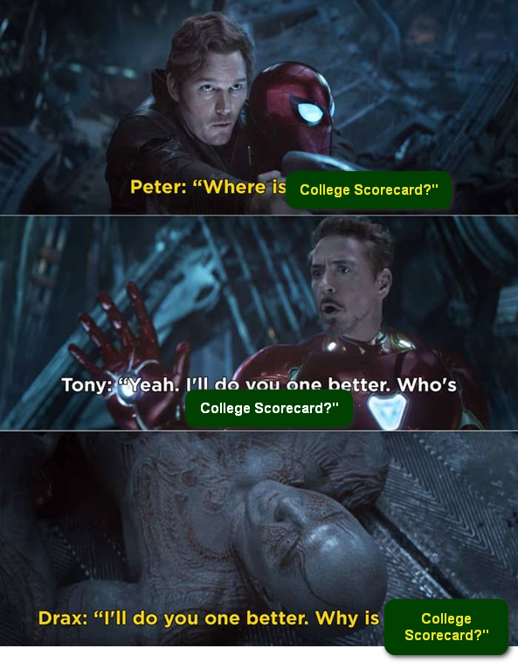
A few important questions
What is the College Scorecard?
Where is the College Scorecard?
Most importantly, Why is the College Scorecard?
https://collegescorecard.ed.gov/

Slide 4
What is the College Scorecard?
Feds compiled different metrics from several sources to give a standardized overview of different campuses – for example
Enrollment | Retention and Success | Cost | Debt and Earnings
Notes:
Started in the Obama administration in 2015. I lucked into becoming the SME when I emailed Huey with a question related to AY vs. Calendar year and was then volunteered to be the SME ☺.

Slide 5
(From) Where is the College Scorecard?
IPEDS Enrollment, retention, grad rate etc. | National Student Loan Data System Debt – Title IV recipients | US Treasury tax records Earnings based on Title IV recipients only
Notes:
IPEDS (Enrollment, retention, grad rate etc.)
National Student Loan Data System (Debt)
US Treasury tax records (Earnings)
Because the population is sourced from NSLDS, limits to only those who received Title IV aid
Debt and earnings for “__ years” after completion
based on separation, not necessarily graduation

Slide 6
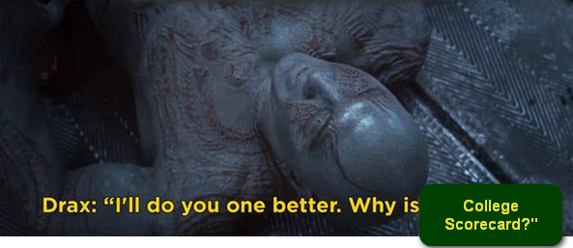
Why is the College Scorecard?
Transparency and Accountability Where there is light, darkness disappears | Prospective Students & Families Informed decisions related to cost, graduation, debt, and earnings | Address Information Asymmetry Many different sources of information made it hard to compare
Notes:
Responding to Calls for Accountability: The creation of the College Scorecard was also a response to growing calls for greater accountability from higher education institutions regarding their costs and the outcomes they provide for students.
Empowering Students and Families: The main purpose was to provide clear, reliable, and accessible data on college costs, graduation rates, student debt, loan repayment, and post-college earnings. This information allows students to compare institutions and determine which one best aligns with their individual needs and goals, and offers the best potential return on investment.
Addressing Information Asymmetry: Before the Scorecard, it was often difficult for students to get a comprehensive picture of college outcomes. The Scorecard aimed to level the playing field by providing standardized data from various federal sources in an easy-to-understand format.

Slide 7

How is it used?
How have you used the data?
Have heard from
  Cornell
    Use publicly viewable data and comparisons in presentations
  Northwestern
    Easy access to data vs. federal sites
  U of Washington
    Benchmarking (Budget and Accreditation)

Slide 8

Field Trip!
https://collegescorecard.ed.gov/

Slide 9
Field Trip! (again)
https://tableau.mit.edu/t/AAUDE/views/CollegeScorecardDashboard_16863244671420/StartPage?%3Aembed=y&%3Aiid=1&%3AisGuestRedirectFromVizportal=y
Notes:
Note that you should be able to find the same values on the dashboard as are presented on the College Scorecard website. Use this to easily compare your institution to AAU, AAU Publics, or AAU Privates.

Slide 10
Future Growth
Outcomes by Field of Study (4-digit CIP)
Financial info Still limited to NSLDS students
Graduates IPEDS numbers | Debt and Loan Payments Debt – Title IV recipients | Earnings Monthly and annual

Slide 11

Thank you!
Zot Zot Zot!

