Slide 1
Administration Reports
Council Meeting
Annual Meeting 2026

Slide 2
AAUDE Mission
AAUDE is a volunteer organization that relies upon the active participation of its members to collect and make accessible useful information that informs decision-making within member institutions and in the broader policy discussions that pertain to research universities.

Slide 3
To fulfill this mission, AAUDE’s core function is the exchange of data/information of common interest including:
(A) The scheduled collection of exchange items as defined by the membership;
(B) The sharing of results of ad hoc inquiries and special studies; and
(C) The promotion of communication and collegiality among the membership. (adopted April 2010)

Slide 4
Users

Slide 5
In 2025, 64 WH users were removed, and 67 users joined
    During 2024 64 users left and 65 new users joined
    WH count is 580
Total current (4/22/2026) active AMO accounts: 614
These numbers include staff and Georgetown

Slide 6
The number of WH users at each campus varies:
Average: 8.3 (7.8 last year)
Least: 2 (2)
Most: 16 (21)

Slide 7
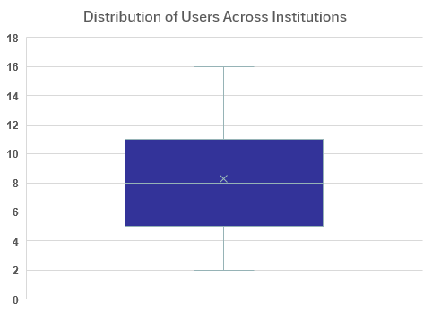
We can advise campuses that 6-11 is the typical number of users.
There is a lot of variability among members.

Slide 8
Number of representative types
Primary: 73
(69 AAU and 3 affiliates, 1 Georgetown)
Alternate: 119
Grad School: 34
Member Analyst: 389

Slide 9
Warehouse Permissions Breakdown
Standard Access: 544
Fac Salary : 437 (was 445)
Grad Data: 34
Fac Profile Only: 68
(FacProfile includes 4 Georgetown users)

Slide 10
Collegiality

Slide 11
Annual meeting Attendance

Slide 12
Onboarding

Slide 13
Newcomers
In addition to welcome emails from the data warehouse staff, new members of AAUDE receive four emails with general information. From April, 2025 through March 2026 65 individuals have received information about AAUDE.
  [New to AAUDE?] (#1): Welcome
  [New to AAUDE] (#2) Management and Governance of AAUDE
  [New to AAUDE?] (#3) Where’s the Data?
  [New to AAUDE?] (#4): Who you gonna call? AAUDE as a community, Ad hoc Queries and comparison metrics
Individuals for whom this is their first annual meeting are matched with Mentors
  There are 14 newcomers to the 2026 Annual Meeting and 14 attendees have agreed to be mentors. Additionally 4 attendees will be serving as ambassadors to meeting sponsors.

Slide 14
Highlighted Accomplishments

Slide 15
A few highlights
Renegotiated space for 2026 annual meeting.
Updated confidentiality policy.
Supported AI Policy Committee
Hired a consultant to work on website simplification.
Worked with consultant on mission discussion and process
Brown bags on protocol and policy, and AAUDE resources
Published Graduate Stipends- New
Instructor Workload Vote
Welcome meetings with new Primary Representatives
Recruited several new SMEs, including from schools without SMEs
Exchange item brown bags
ACTS discussion
Quick information turnaround for AAU

