Slide 1
Common Data Set
Update & Feedback
AAUDE Annual Meeting
April 29, 2026

Slide 2
Goals For Today
Why and how we got here (5 min)
DSV development (~5 min)
Warehouse tables (~5 min)
Tableau visualizations (~5 min)
Discussion (~20+ minutes)
Value and usage of exchange item for your institution
Which parts of the CDS are most valuable to you – what should we focus on next?
Thoughts on visualizations & analysis

Slide 3
Work to date…
Formed initial committee – AAUDE staff, two institutions
Settled on PDF forms (i.e. the CDS fillable forms)
https://commondataset.org/wp-content/uploads/2024/11/CDS-2024-2025-TEMPLATE.pdf
US News
Identified two parts of CDS
Not publicly available via IPEDS, AAUDE Exchange
Quantifiable
Built Python to ingest PDF and DSV to submit
Built warehouse tables & metadata - https://web-cert.mit.edu/aaude/metadata/stars.html#80
Built Tableau visualizations (https://tableau.mit.edu/#/site/AAUDE/projects/1720)
Financial Aid, Transfer Students
Notes:
Call out to Weini

Slide 4
Next Steps
Build out additional data areas
Get feedback from AAUDE institutions
Follow up with Tableau visualizations
Publicize work to date / Brownbag?
Update web page for exchange item (https://www.aaude.org/exchange-items/other-exchange-items/common-data-set/ )
Gather additional institution data
Notes:
Do we need membership vote?
PDF Download of institutional files

Slide 5
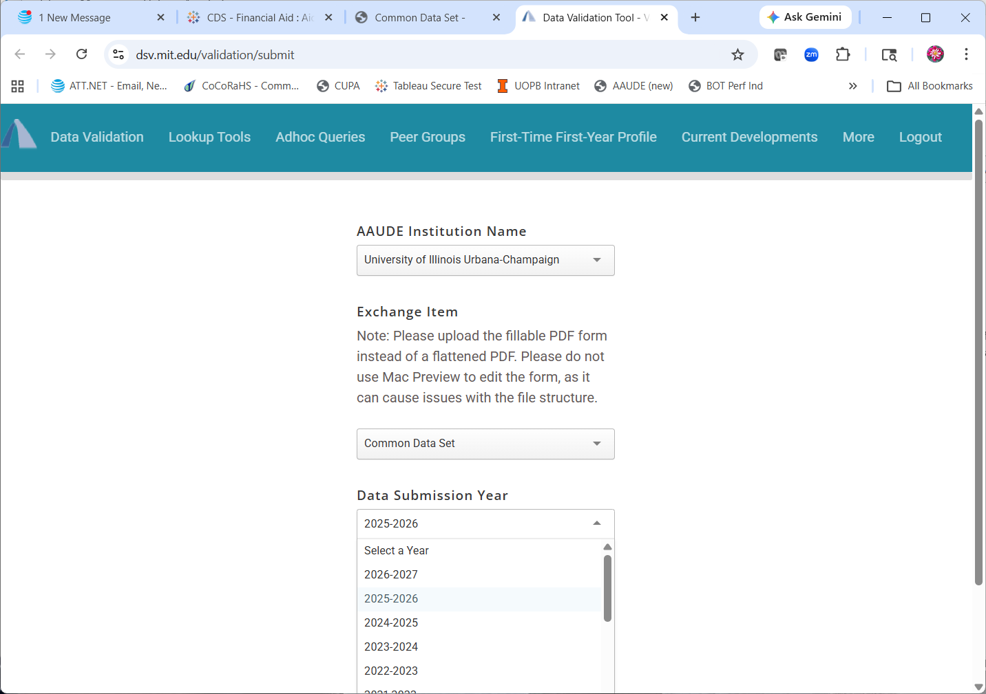
DSV
https://dsv.mit.edu/validation/submit

Slide 6
Warehouse Tables
4 warehouse files to store the CDS finaid data.
  CDS_FINAID_AWARDED_TOTAL
  CDS_FINAID_AWARDED_STU_DETAIL
  CDS_FINAID_LOAN_BORROWED_DETAIL
  CDS_FINAID_OTHER_RESPONSE_DETAIL
4 warehouse tables to store the CDS transfer admission data
  CDS_TRANSFER_APPLICANT_DETAIL
  CDS_TRANSFER_APPLY_DATE_DETAIL
  CDS_TRANSFER_APPLY_ITEM_DETAIL
  CDS_TRANSFER_RESPONSE_DETAIL

Slide 7
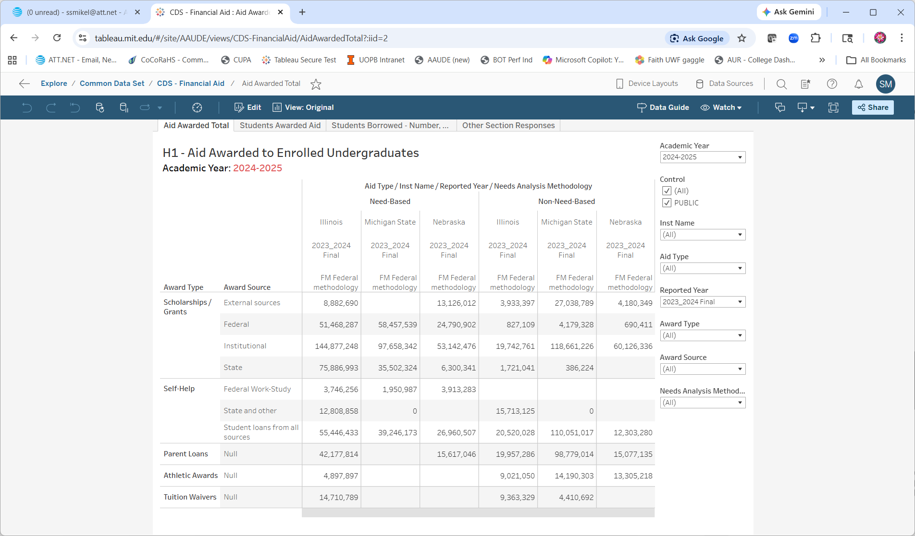
Tableau Visualizations
https://tableau.mit.edu/#/site/AAUDE/projects/1720

Slide 8
How do we use or want to use this data?

Slide 9
Which parts of the CDS are most valuable to you – what should we focus on next?

Slide 10
CDS Items to Consider
A. General Information
B. Enrollment & Persistence
C. First-Time, First-Year (Freshman) Admission
E. Academic Offerings and Policies
F. Student Life
G. Annual Expenses:
I. Instructional Faculty and Class Size

Slide 11
Thoughts on visualizations & analysis

