Slide 1




Slide 2
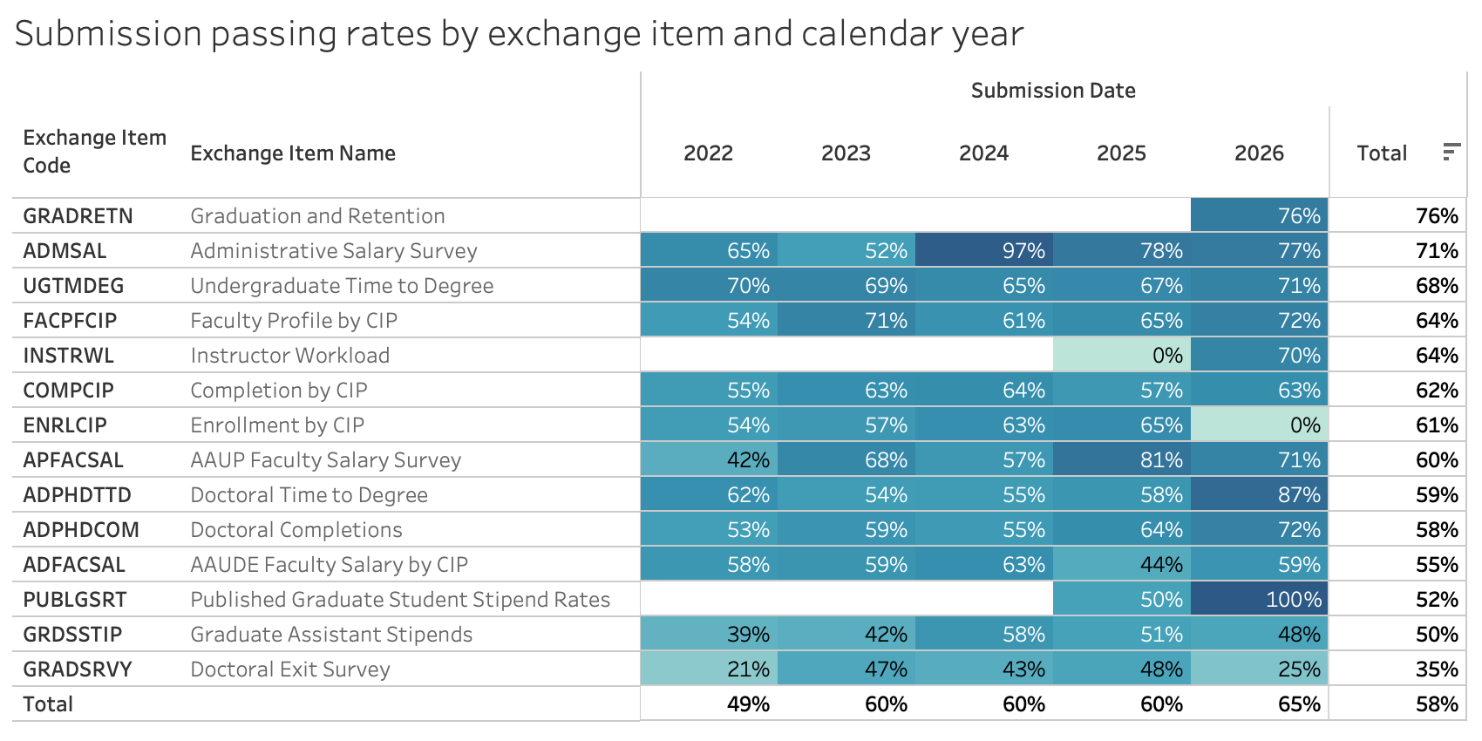


Slide 3
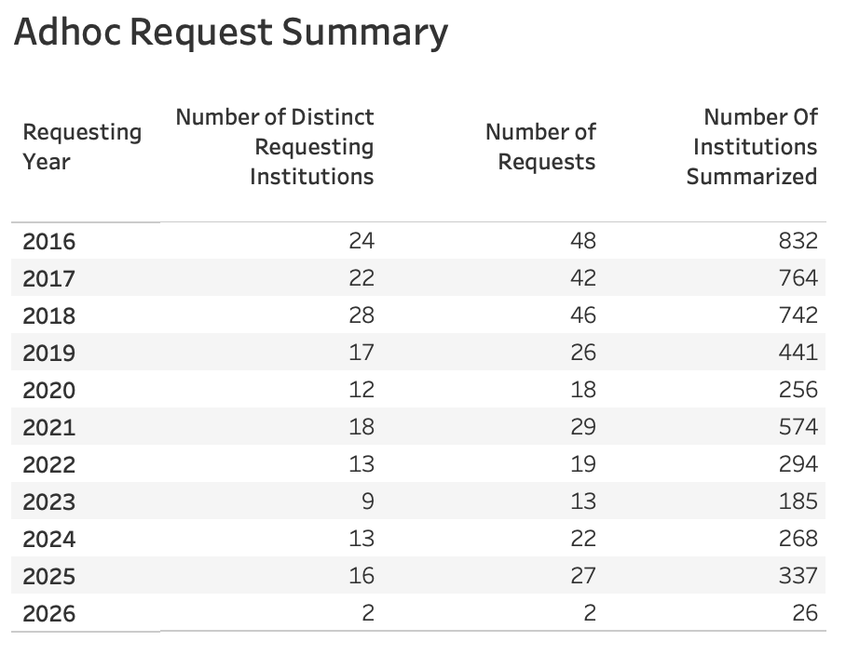
Notes:
Data extracted on 04/23/2026
This chart only includes most recent 10 years of data
Ad-hoc items with ”Standard Peer Group” as the requesting institution are not included

