Slide 1


AAUDE Lightning Talk – Association of American Medical Colleges Exchange Item
April 28, 2026

Slide 2
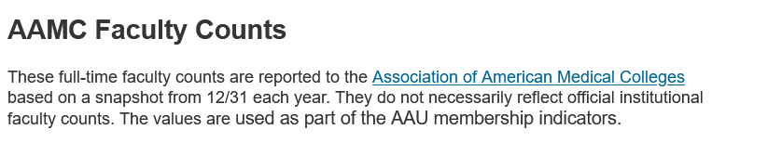
Summary of AAMC Warehouse Item
Basic Sciences (departments such as Anatomy, Microbiology, Physiology;
Clinical Sciences (Anesthesiology, Dermatology, Internal Medicine);
Other: Other types of departments in the medical college.

Slide 3
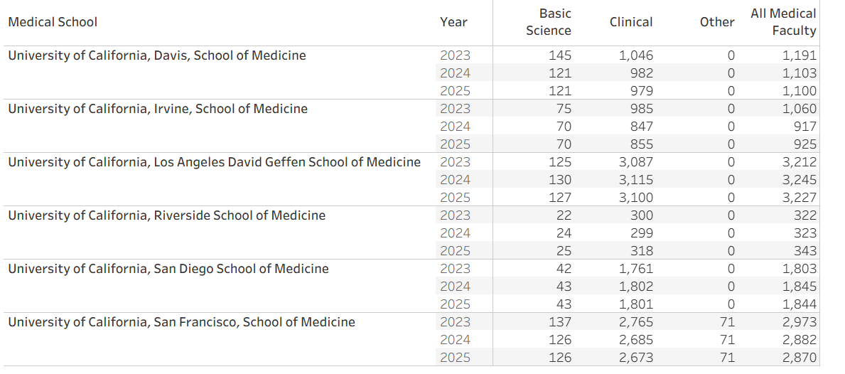
Basic Science, Clinical, Other Numbers from AAMC for Medical Colleges in the University of California

Slide 4
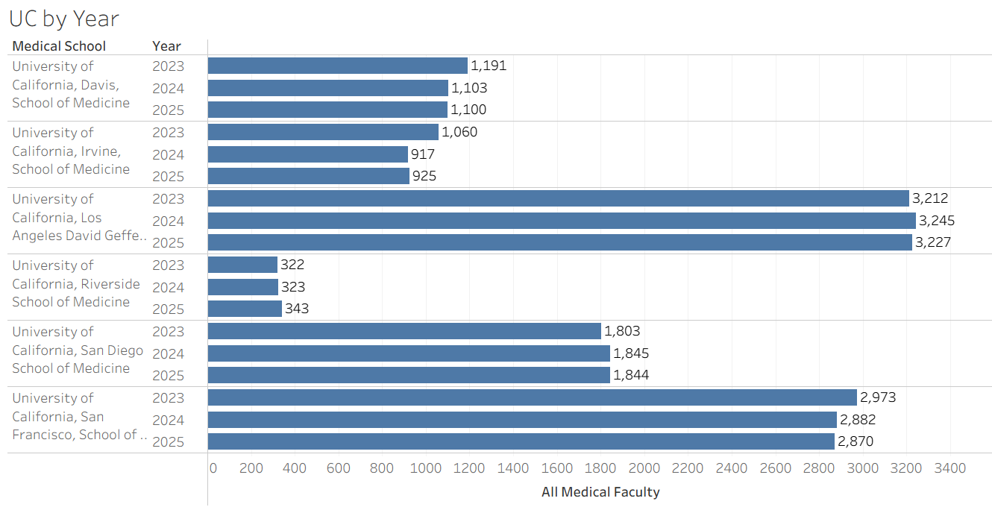
Overall Trends of the
Medical Colleges in the University of California

Slide 5
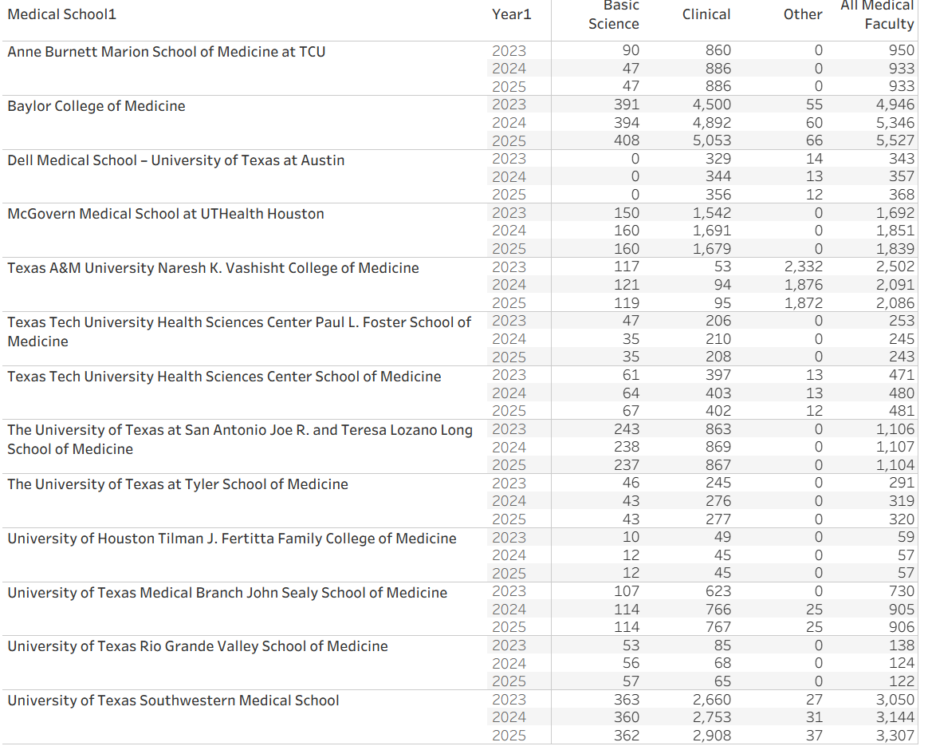
Snapshot of Medical Colleges in Texas, AAU and non-AAU

