Slide 1

2026 AAUDE Annual Meeting
AAUDE Data Warehouse Update
April 27, 2026
Huey Chan, Weini Chen
aaude-warehouse@mit.edu
aaude-help@mit.edu
2026/04/21

Slide 2
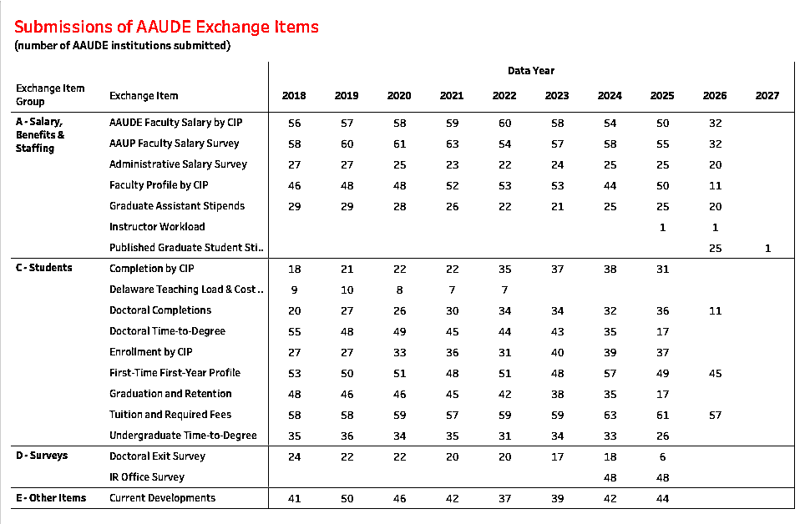
as of April 20, 2026
29 privates + 42 publics = 71 institutions + 1 UCOP = 72 members

Slide 3
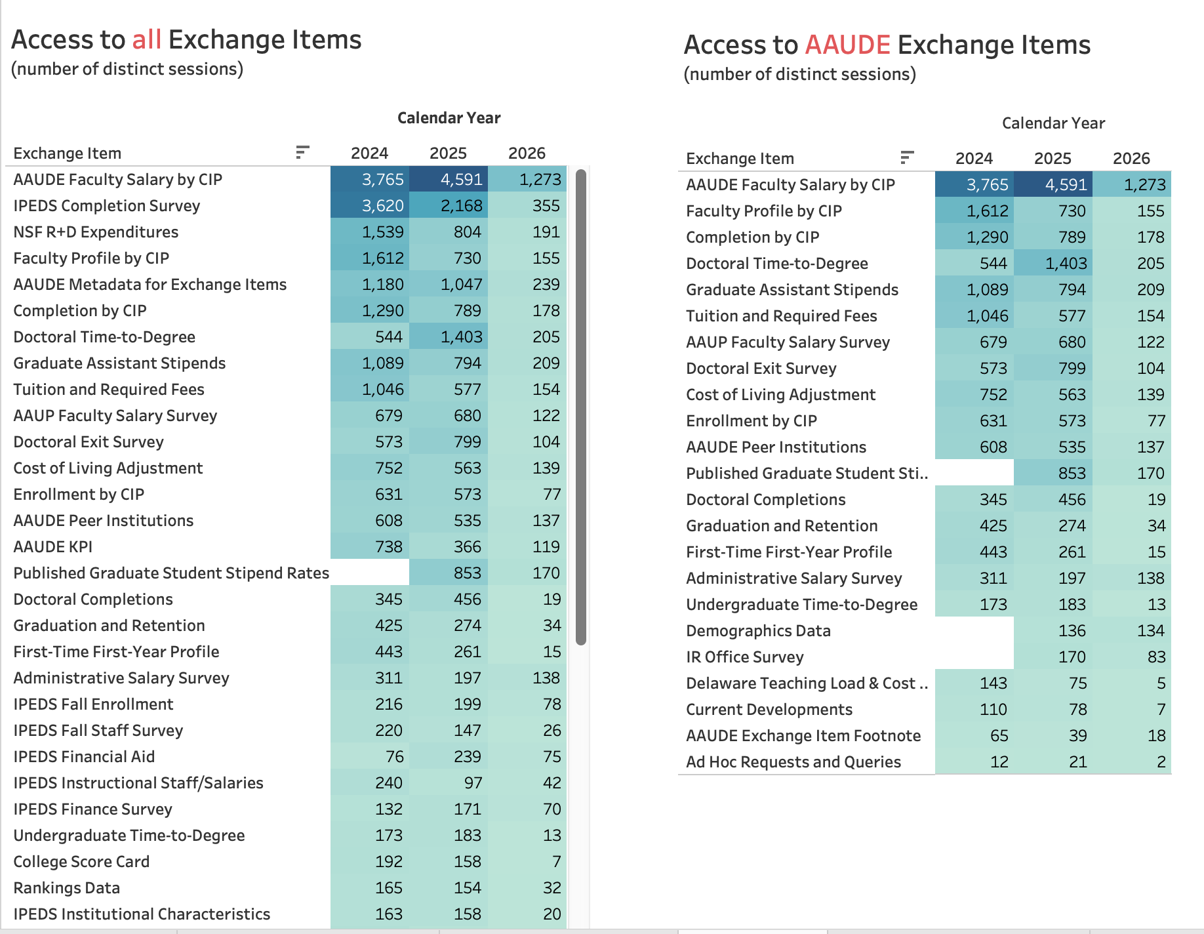
(as of 04/18/2026)
Notes:
This is a slice of the Usage Statistics in the Warehouse. How have AAUDE users been using the data, the exchange items.
LHS. All exchange items, including IPEDS, NSF, and other public sourced data that we load into the Warehouse.
RHS shows the AAUDE developed exchange items.

Slide 4
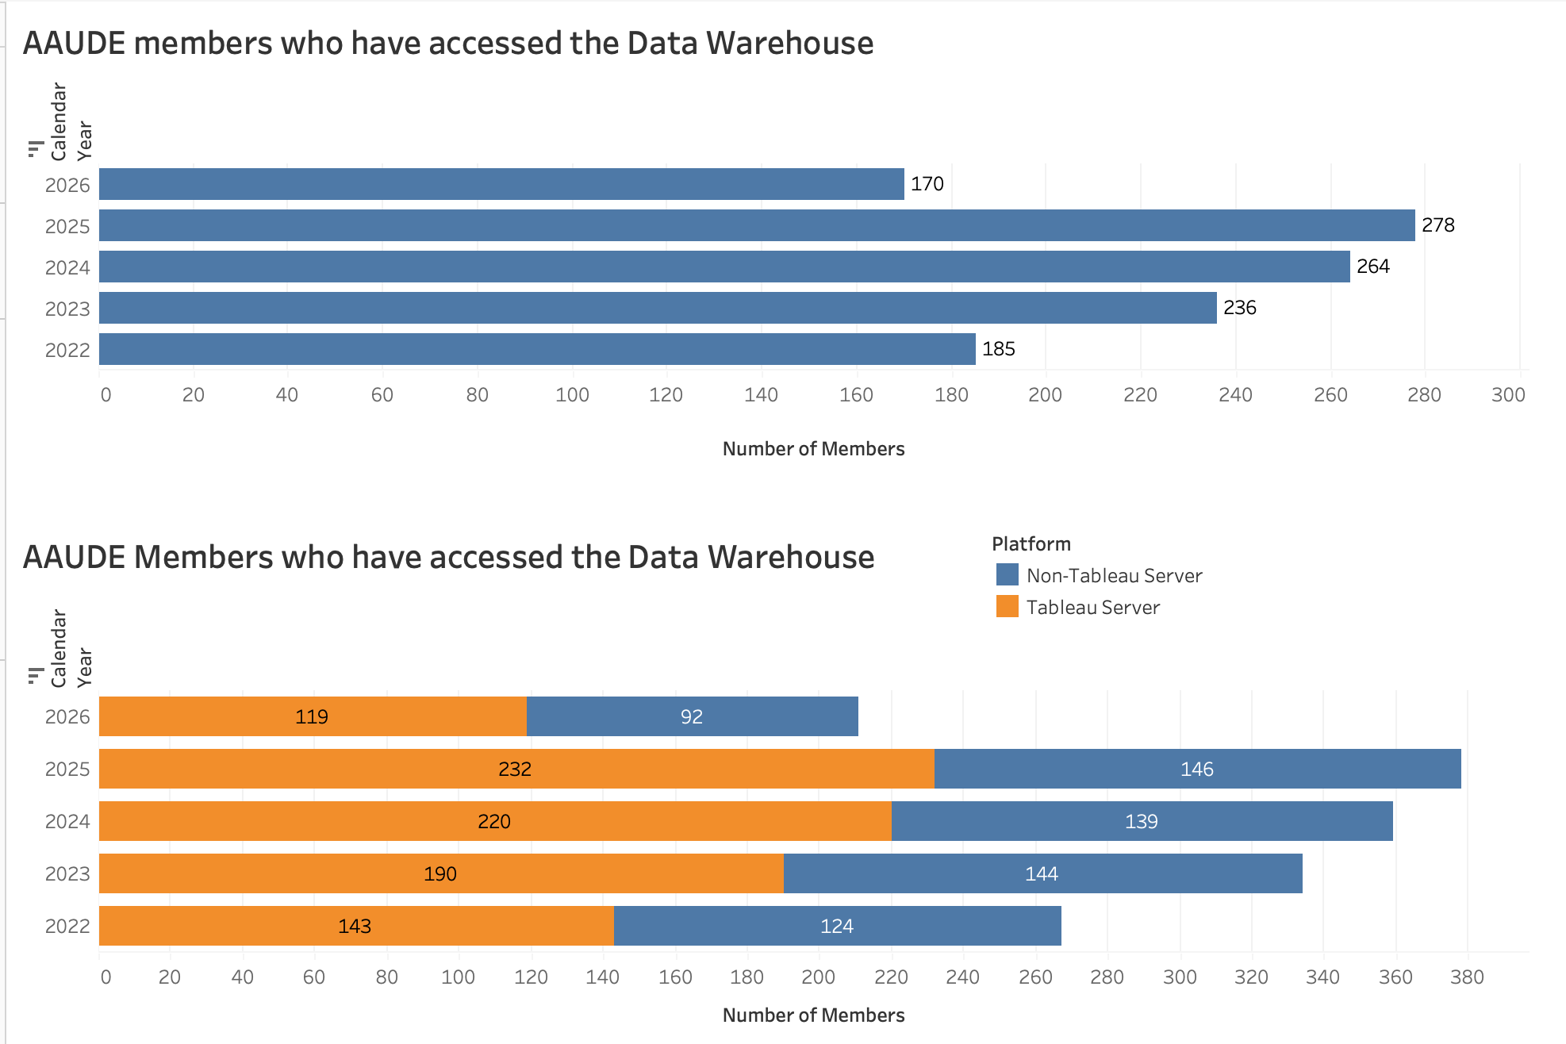
(as of 04/18/2026)

Slide 5
Highlights of some of the work in the past year
Graduation and Retention (CSRDE)
Instructor Workload
Common Data Set (CDS)
Ad-Hoc Requests
AAUDE Peer Institutions
AAUDE Listserv
Aggregated Faculty Salary by CIP-4 for selected Peer Groups
Institutional Data by CIP (Demographics by CIP)
  Student Enrollment, Student Completion, Faculty Profile
Support and Maintenance
  Data Submission, Data Access, Connections to DB and servers
  Server and database infrastructure and maintenance

